Slide 1
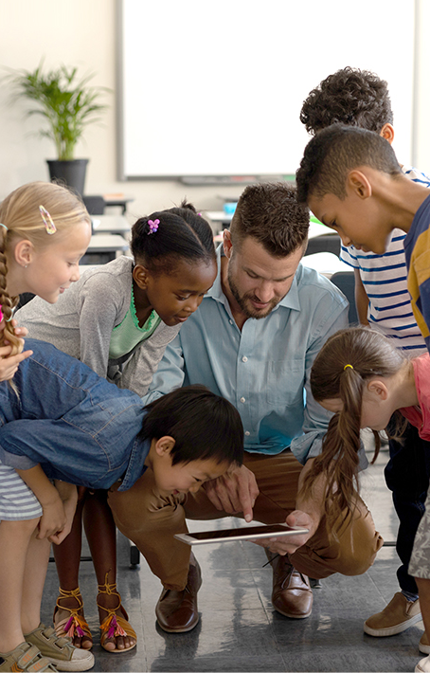


Technology in the Early Years
Notes:
Use the image Comms selects to advertise the session

Slide 2
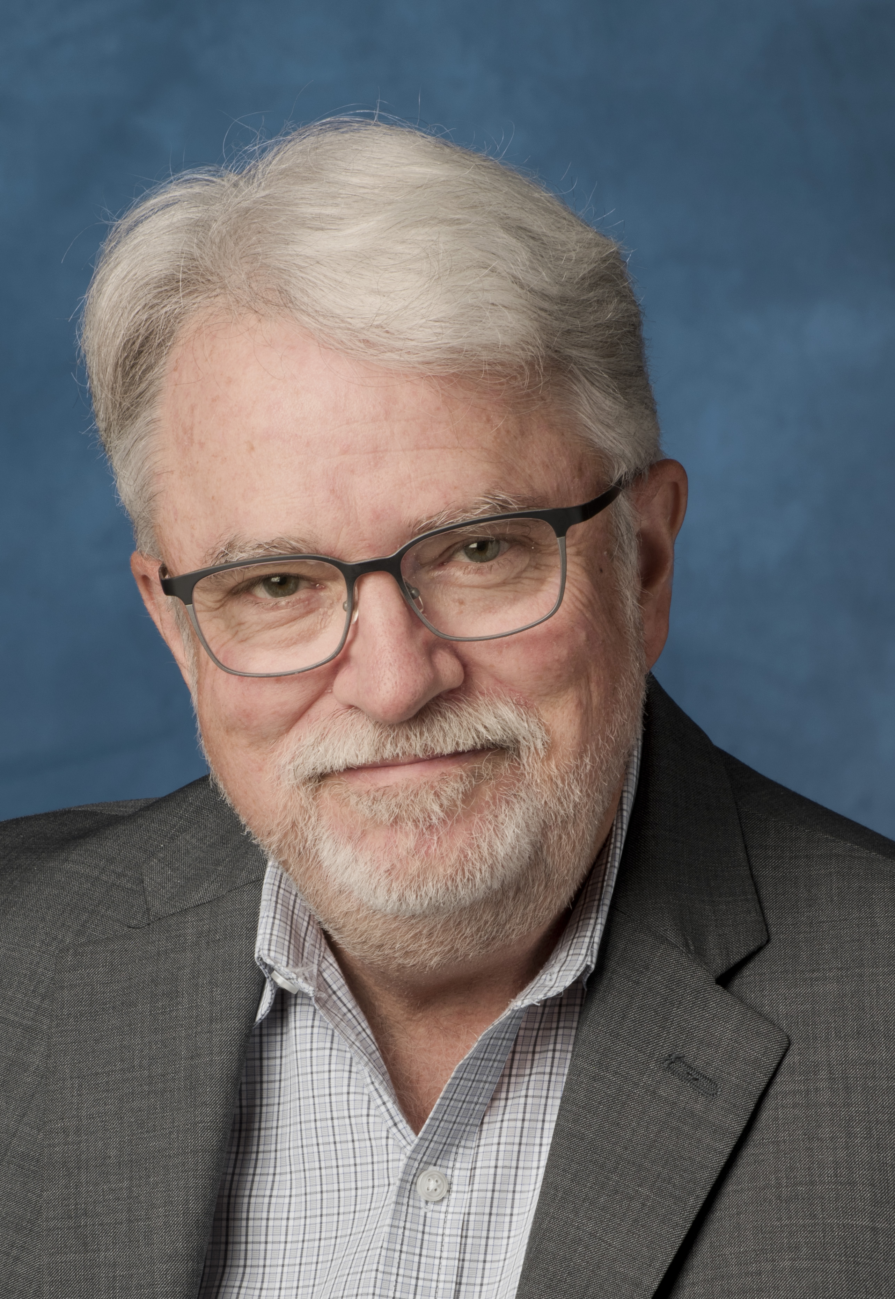
Lead panelist
Founding director of the Technology in Early Childhood (TEC) Center at Erikson Institute and senior fellow at the Fred Rogers Center for Early Learning and Children's Media
Dr. Chip Donohue
Notes:
Chip headshot

Slide 3
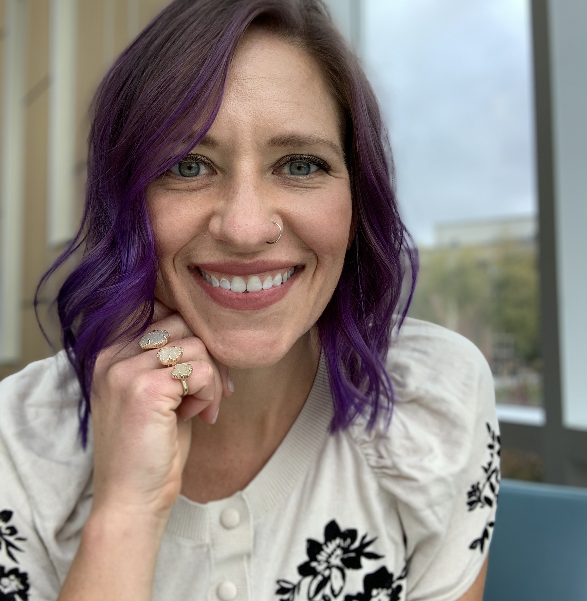
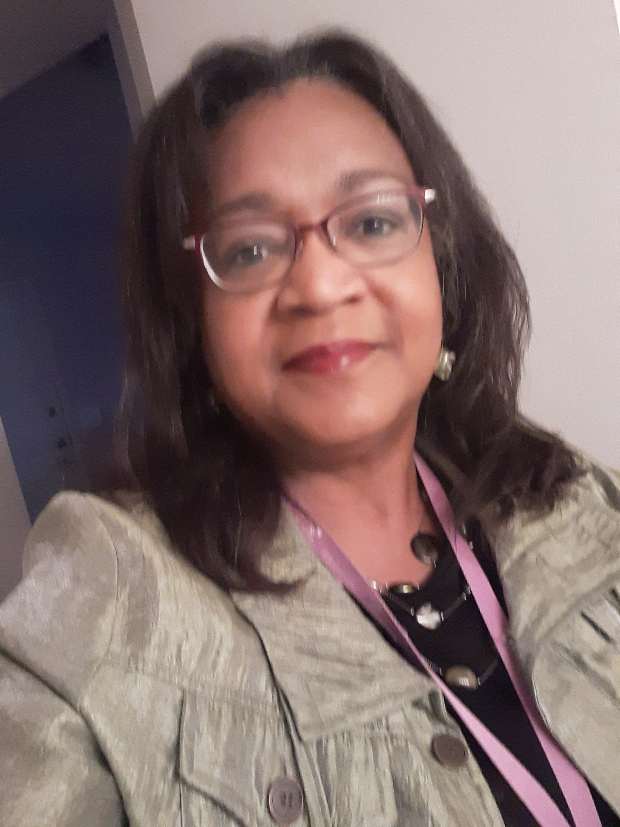
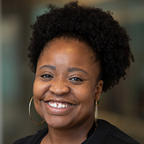
Panelists
Dr. Anne Karabon
assistant professor of early childhood and STEM education at the University of Nebraska at Omaha
Gwen Gideon
director of the Omaha Early Learning Center at Skinner
Keeley Bibins
parent of children involved in remote learning and an educational facilitator at the Buffett Early Childhood Institute
Notes:
Get panelists headshot

Slide 4
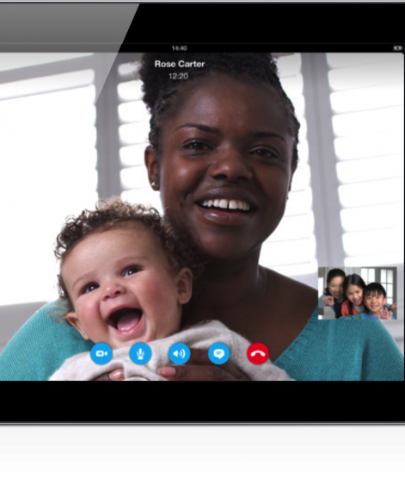
From “Shelter in Place” and “Social Distancing” to the “Next New Normal”
Adults have gained essential tech skills
While juggling old and new roles
Gone from “wondering if” to “relying on”
Instead of worrying about screen time, let’s celebrate…Screens as lifelines
Notes:
Chip setting the context

Slide 5
Today’s key concepts
Relationships matter most
Reimagine screen time as beneficial
Healthy media diet
Media mentors

Slide 6
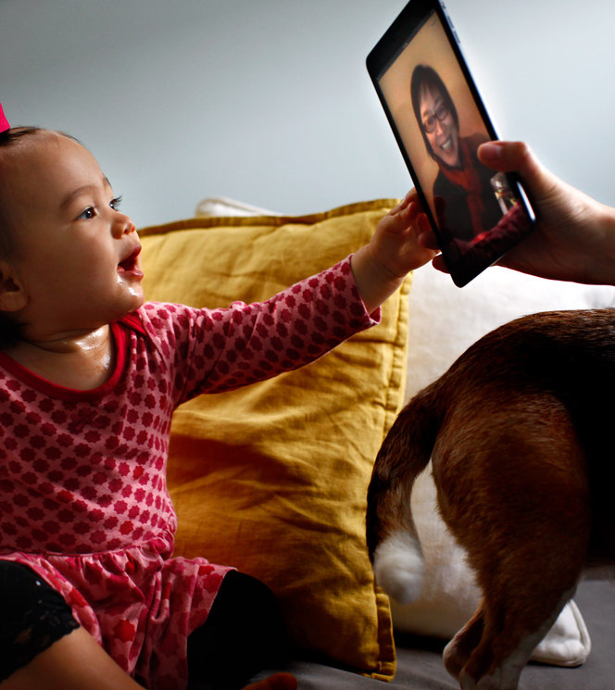
Relationships matter most
Using media together leads to more learning
  Co-viewing and joint engagement matter
  Lessons from early literacy and language development matter
  Socially contingent interactions matter
  Look for interactive media plus interactions with others
Quality time together can include screens.
Notes:
ADDED- HIGHLIGHT THIS CONCEPT.
Trust your instincts
Begin with what you know
It’s about relationships
Acknowledge concerns and benefits
Promote joint engagement and social emotional learning
Model healthy media habits and “digital well-being”
Be a media mentor
RELATIONSHIPS
Early childhood educators always should use their knowledge of child development and effective practices to carefully and intentionally select and use technology and media if and when it serves healthy development, learning, creativity, interactions with others, and relationships.
Reflect upon the Fred Rogers’ quote, “let's not get so fascinated by what the technology can do that we forget what it can't do...It's through relationships that we grow best and learn best." Brainstorm and compare 2 lists: “what can technology do?” and “what can technology not do?”
Reflect upon the quote, "No matter how helpful computers are as tools (and of course they can be very helpful tools), they don't begin to compare in significance to the teacher-child relationship which is human and mutual. A computer can help you learn to spell HUG, but it can never know the risk or the joy or actually giving or receiving one." Rogers, F. (1994). You are special: Words of wisdom from America’s most beloved neighbor. (p. 89). New York: Penguin Books.

Slide 7

Avoid the false dichotomy
It’s not either/or
It’s not all tech or no tech
It’s not tech or play
It’s not tech or nature
It’s not screens are bad or screens are good
It’s not “children are more isolated than ever” or “children are more connected than ever”
You can address problematic screen use and find ways to maximize benefits—it’s never either/or.
Notes:
Consider adding for REIMAGINE SCREEN TIME AS BENEFICIAL
This is really important and has really resonated with teachers so far. Our field is conditioned to believe that screens are bad. This idea is helping teachers feel a sense of relief and release. ”OK, screens are not all bad. I can make screentime be positive.”

Slide 8
Not all screens are created equal
What we do on screens and how we do it is more important than time spent.
Common Sense Media
Notes:
8

Slide 9
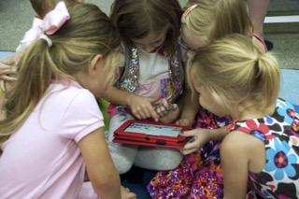
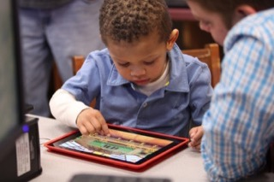
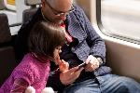
Reimagine screen time as beneficial
Active not passive or sedentary
Interactive not isolating
Inclusive not exclusive
Enhancement not displacement
Meaning making not meaningless
Creation not just consumption
Tool for learning and teaching
Lifeline for connections not disconnections
…it’s never either/or
Notes:
Active not passive or sedentary
Interactive not isolating
Inclusive not exclusive
Enhancement not displacement
Meaning making not meaningless
Creation not consumption
Tool for learning not teaching

Slide 10
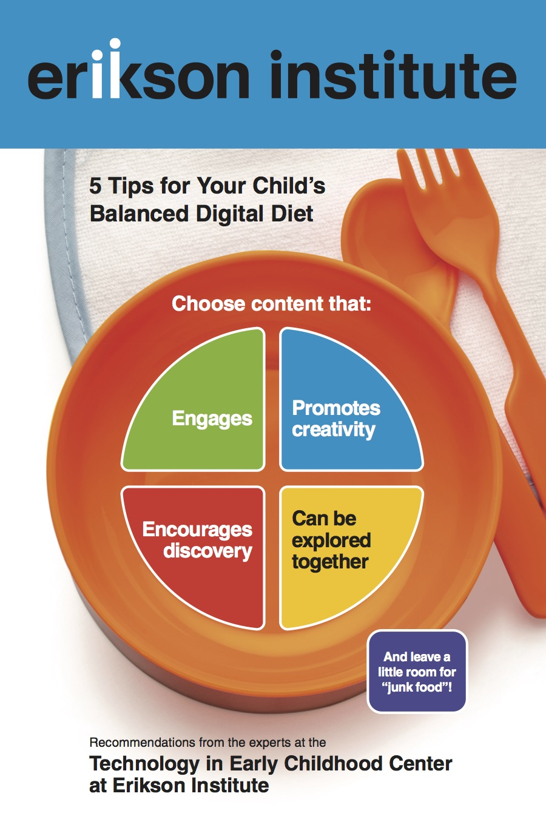
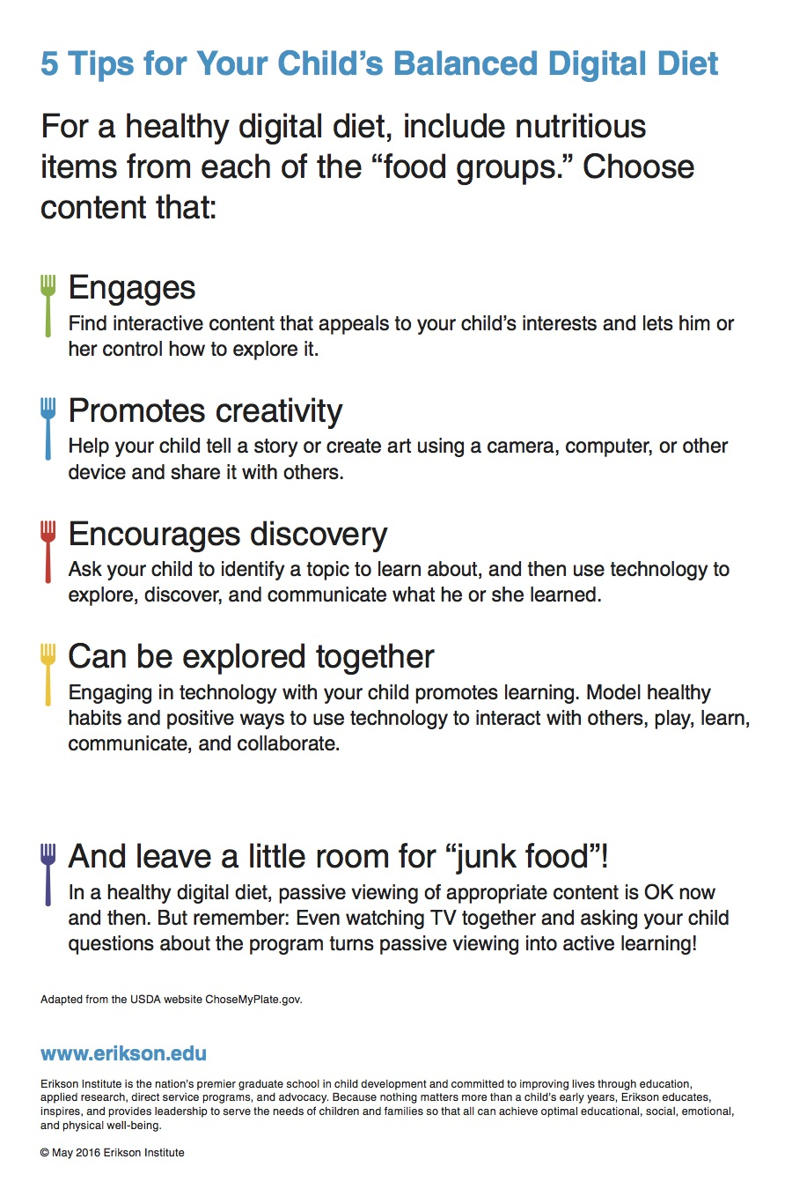
Healthy media diet
Notes:
HEALTHY MEDIA DIET
Consider deleting the next 2 slides, but talking through these points while participants view this slide.
PROMOTE A HEALTHY MEDIA DIET
Don't feel guilty. You’ve got this!
Move from screenworried to screenwise
Aim for balance instead of counting minutes
Use media “with” rather than “instead of”
Shift from “how much” to “what they watch”
Content matters
Watch together, talk about it, let them show you
Encourage video chat – Screens as lifelines
Create tech-free times and zones
Plan ahead for “unplugged time”
Be a present, intentional, engaged, digital role model and media mentor

Slide 11
Media Mentors
Help children and families get the most out of technology
Address screen time concerns and benefits
Help parents become screenwise
Identify learning strategies
Encourage digital wellness and living well with media
Connect parents to community resources for early learning and tech
Notes:
ADDED- THIS CONCEPT HAS REALLY RESONATED WITH OUR AUDIENCE
This slide has less text.
MEDIA MENTOR
Children already have these devices in their hands, so grown-ups need to make sure screen use is beneficial
Help them navigate a seamless online-offline world
Help them cultivate the capacity to use tech tools to communicate, collaborate, cooperate, connect and learn
Help them embrace tech tools that inspire their curiosity, and creativity and encourage them to be media creators
Help them define and maintain a healthy diet of tech use – to learn what it feels like to be “full”
Help them gain skills they will use in school, work and life
Help parents move from screenworried to screenwise
Screen time meant 1 child watching 1 TV, but children live in a multi-screen world today
Screen time increased during shelter-in-place
Children have to use screens during remote learning
Time is a metric, but is just one way to determine how much screen time is too much
Shift from “how much” they watch to “what they watch”
Look for the 3Cs – Content + Context + Child

Slide 12


8 powerful ideas for parents and educators
Trust your instincts
Begin with what you know
It’s about relationships
Acknowledge concerns
Reimagine screen time as beneficial
Promote joint engagement and social-emotional learning
Model healthy media diet and “digital well-being”
Be a media mentor
Notes:
CHIP will summarize with slides 14 and 15 after panelists.
12
Sleep disruptions – Manage screen use before bedtime
Language learning – Children learn language from interactions with others, not from screens
Social Emotional Learning – Look for interactive media that invites and encourages interactions with others
Joint engagement – Use media together to enhance learning and co-engagement
Sedentary behavior – Use technology to encourage kids to be active, go outside, and explore their world
Displacement - Early years essentials are non-negotiable
Well-being – Strive for balance and a healthy family media ecology

Slide 13
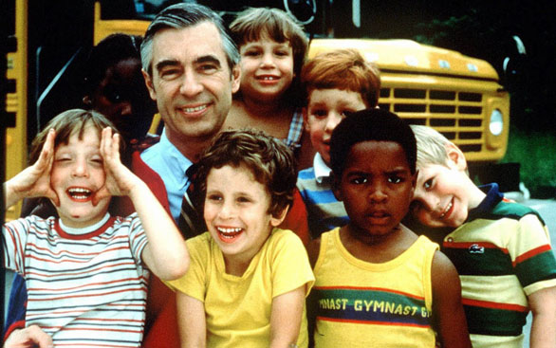
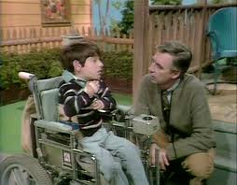
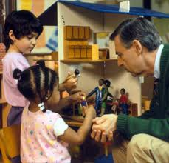

What is essential is invisible to the eye
…Let’s not get so fascinated by what the technology can do that we forget what it can’t do…It’s through relationships that we grow best and learn best.
Notes:
Chip
Roberta

