Slide 1
Oral Language Development
Kindergarten - Grade 3

Slide 2
Greeting: Hi - Definition
Each participant will be handed a card with a descriptive word or a sentence using the word.
Then mingle, and find the participant with the matching card.
When you find your match, greet each other with a friendly “Hello!” and then sit down to decode the meaning of your word by using the context clues in the sentence.
Now talk about how you might use this in your classroom to enriched vocabulary.
Return to seats when finished.
Greeting!!!

Slide 3
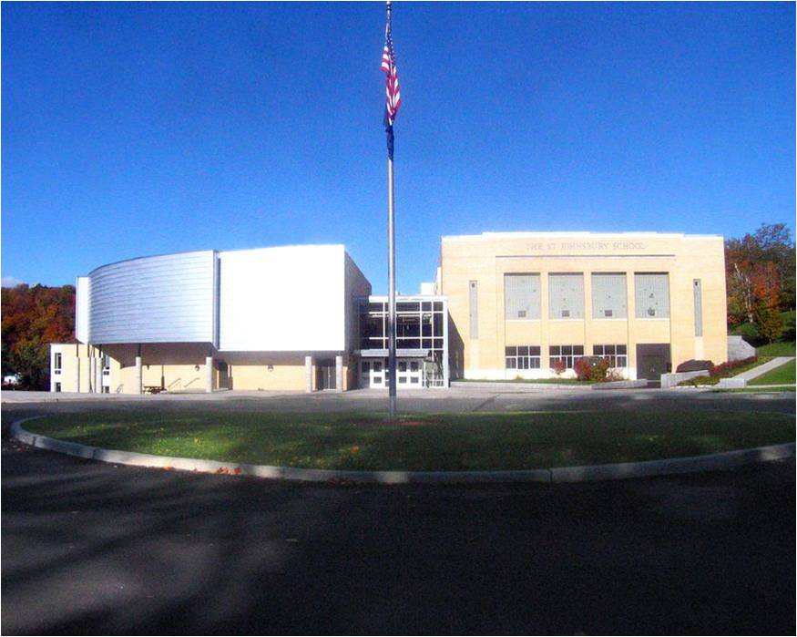
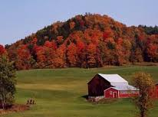
The St. Johnsbury School
St. Johnsbury, Vermont
The St. Johnsbury School
St. Johnsbury, Vermont
Pre K - 8
680 Students
64.50 % Free/Reduced
State Average: 42.50 %
Pre K - 8
680 Students
64.50 % Free/Reduced
State Average: 42.50 %
St. Johnsbury Population: 7, 600
Median Household Income: $33,100
State: $54,900
St. Johnsbury Population: 7, 600
Median Household Income: $33,100
State: $54,900

Slide 4
First school
Race to the Top - What does that mean?
Edusnap and CLASS
VELS - Vermont Early Learning Standards - Birth to Grade 3 - Uses the Common Core.
First School - What is this? And why is it helpful?

Slide 5
FRom Teaching With Poverty in Mind - Eric Jensen
The quality, quantity, and context of parents’ speech matter a great deal (Hoff, 2003).
Children’s vocabulary is influenced by mother’s socio-demographic characteristics, personal characteristics, vocabulary, and knowledge of child development (Bornstein, Haynes, & Painter, 1998).
By the time children are school-aged they will have been exposed to 5 million words and should know about 13,000 of them (Huttenlocher, 1998).

Slide 6
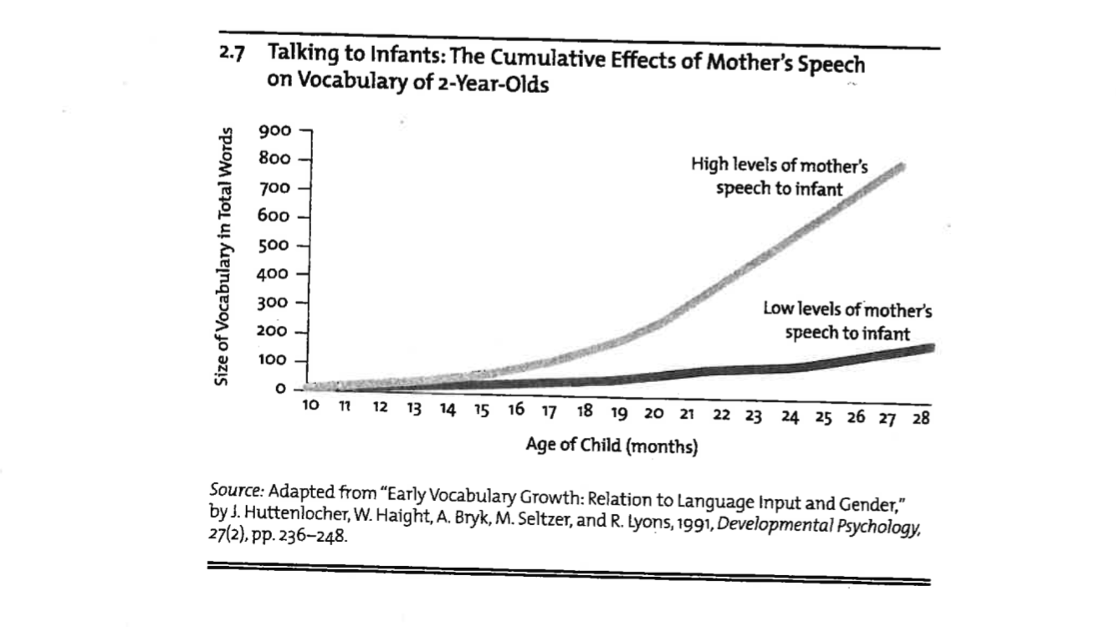

Slide 7
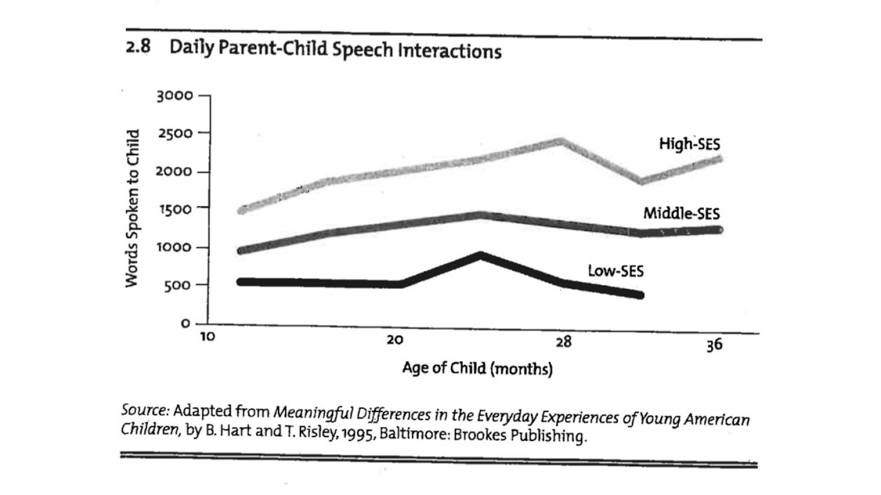

Slide 8
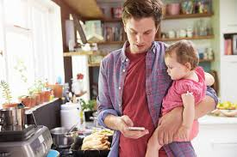
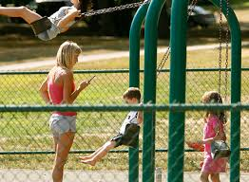
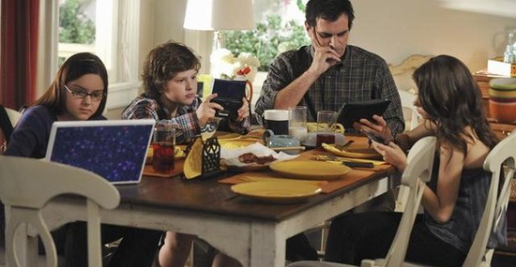

Slide 9
“Reading and writing float on a sea of talk.”
James Britton
“The limits of your language are the limits of your world.”
Ludwig Wittgenstein

Slide 10
Oral Language
Oral language is the system through which we use spoken words to express knowledge, ideas, and feelings. Developing oral language, then, means developing the skills and knowledge that go into listening and speaking—all of which have a strong relationship to reading comprehension and to writing. Oral language is made up of at least five key components (Moats 2010): phonological skills, pragmatics, syntax, morphological skills, and vocabulary (also referred to as semantics). All of these components of oral language are necessary to communicate and learn through conversation and spoken interaction, but there are important distinctions among them that have implications for literacy instruction.

Slide 11
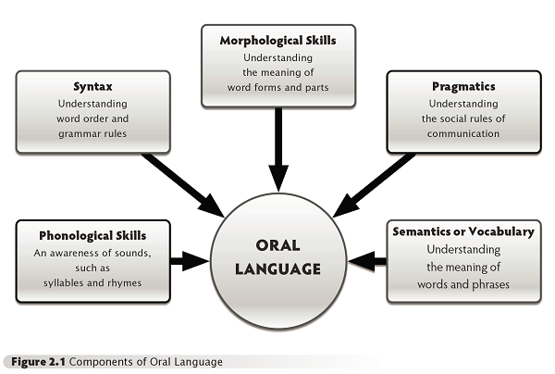

Slide 12
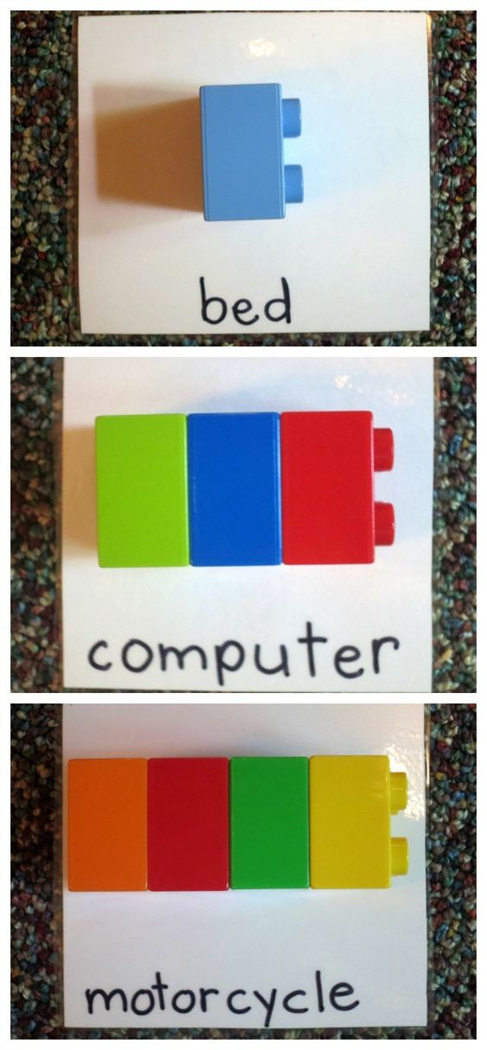
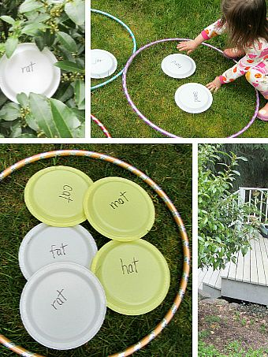
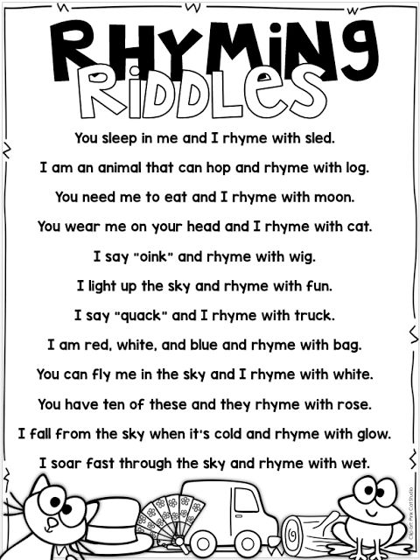
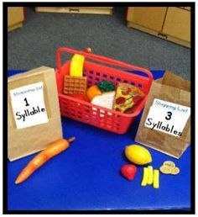
Phonological Skills
A student’s phonological skills are those that give her an awareness of the sounds of language, such as the sounds of syllables and rhymes (Armbruster, Lehr, and Osborne 2001).

Slide 13
Simple phonemic greetings or activities to be done in meeting from Responsive classroom
Activity: Syllable Drama
Introduce activity: Our activity has a lot of movement, so you’ll need to show self-control. Stay in your spots and move your hands and feet in safe ways, just as we’ve talked about and practiced.
State a verb and have the class clap out syllables and then act out verbs.
Greeting: Hickety Pickety Bumble Bee
Post the chant and read it aloud for students.
Hickety Pickety Bumble Bee
Won’t you say your name for me?
Let’s all say it.
Let’s all clap it.
1 syllable Jump, jog, dance, march, bow, waltz, hop, stroll, drive, sway, freeze, tap, strut | 2 syllable Wiggle, gallop, curtsey, giggle, shuffle, tiptoe, waddle, zigzag, moonwalk, balance, dribble, saunter | 3 syllables Exercise, meander, concentrate, celebrate, irritate, decorate, unfasten

Slide 14
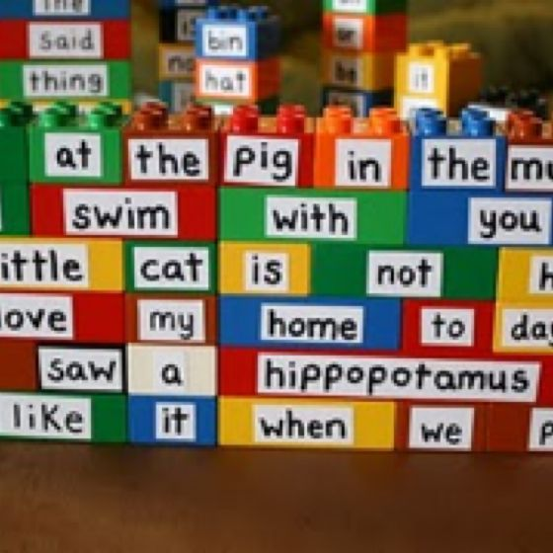
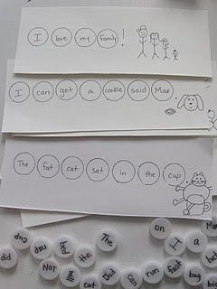
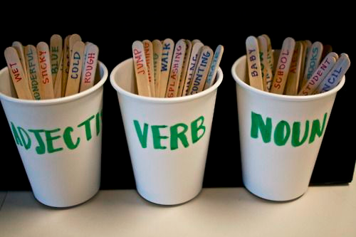
syntax
Syntax refers to an understanding of word order and grammatical rules (Cain 2007; Nation and Snowling 2000).

Slide 15
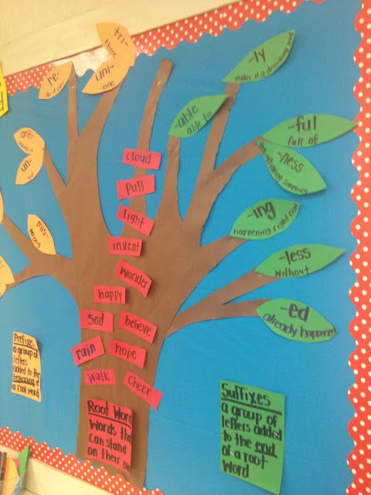
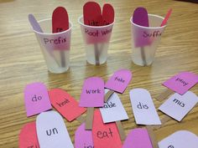
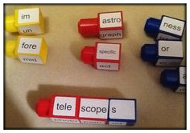
Morphology
Morphology refers to the smallest meaningful parts from which words are created, including roots, suffixes, and prefixes (Carlisle 2000; Deacon and Kirby 2004).

Slide 16
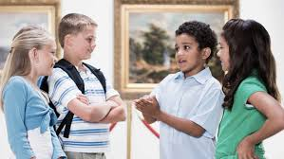
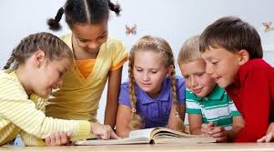
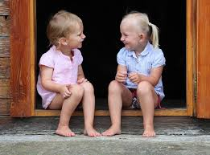
pragmatics
Pragmatics refers to an understanding of the social rules of communication (Snow and Uccelli 2009). This includes what we say, how we say it, and our body language.

Slide 17
Simple pragmatic greetings or activities to be done in meeting from second step
Name
that feeling

Slide 18
Vocabulary knowledge
Vocabulary knowledge— is also a key part of oral language, not to mention comprehending and communicating using print (Beck, McKeown, and Kucan 2013; Ouellette 2006).
Vocabulary knowledge, also referred to as semantic knowledge, involves understanding the meanings of words and phrases (aka receptive vocabulary) and using those words and phrases to communicate effectively (aka expressive vocabulary).

Slide 19
Teach the Meaning of Critical, Unknown Vocabulary Words
Children’s vocabulary in the early grades related to reading comprehension in the upper grades. 
Preschool – Children’s vocabulary correlated with reading comprehension in upper elementary school. (Tabors, 2001) 
Kindergarten – Vocabulary size was an effective predictor of reading comprehension in middle elementary years. (Scarborough, 1998) 
First Grade – Orally tested vocabulary was a proficient predictor of reading comprehension ten years later. (Cunnningham and Stanovich, 1997) 
Third Grade – Children with restricted vocabulary have declining comprehension scores in later elementary years. (Chall, Jacobs, & Baldwin, 1990)
Reading First National Conference, 2008

Slide 20
Simple Vocabulary greetings or activities to be done in meeting from Responsive classroom
Greeting: Hi - Definition
Give each student a card on which you’ve written a vocab word or a sentence using the vocab word.
Students mingle, trying to find the student with the matching card.
When students find their match, they greet each other with a friendly “Hello!” and then sit down to decode the meaning of their word by using the context clues in the sentence.
Students explain their word and meaning. Sharing how they know.
Activity : Say It!
Begin by saying one word, for example “tree”
The students to your right says he associates with the word tree, perhaps “brown.”
The next students in the circle says a word she associates with the words brown, such as “chocolate.”
Continue this pattern around the circle.
Invite observations from the class. What kind of words did we choose?

Slide 21
Continued...
Activity: Shades to meaning
Introduce the group activity “Many words have similar meaning. For example ‘chilly’ and ‘freezing’ both mean cold, but they represent different degrees of cold. Today we are going to use our bodies to rank some words with similar meanings.”
Extend your hands out in front of you, horizontal to the ground. “This is the starting point for ranking words. For example, this is where we would put our hands to rank with word ‘cold’ - right in the middle. If the next word was colder we would move our hands closer to our feet,
if the next word was warmer, we will move our hands up.”
3. Say “freezing” and move your hands down towards your feet. Say “chilly” and move your hands up. Explain that it’s ok if people rank the words differently.
Flow, gush, flood, trickle
Run, race, zoom, speed
Small, itsy, bitsy, teeny, tiny
Quiet, silent, noiseless, hushed
Loud, earsplitting, noisy, booming
Large, enormous, gigantic, big

Slide 22
What is Oral Language?
Information Sharing 
Telling Others How You Feel 
Advice 
Persuading Others 
Entertaining 
Sharing Ideas 
Remembering 
Special Situations
Reading First National Conference, 2008

Slide 23
Is it possible for teachers to design instruction that will close the language experience gap?
YES!
Teachers can be instrumental in closing the language experience gap. Students who struggle with a language deficit will need many language-rich experiences, as well as systematic and explicit instruction to help them catch up to their more verbal peers!
Reading First National Conference, 2008

Slide 24
Kindergarten
Presentation of Knowledge and Ideas.
Describe familiar people, places, things, and events, and with prompting and support, provide additional detail.
Add drawings or other visual displays to describe additional details.
Speak audibly and express thoughts, feelings, and ideas clearly.
Comprehension and Collaboration
Participate in collaborative conversations with diverse partners about kindergarten topics and texts with peers and adults in small and larger groups.
Follow agreed-upon rules for discussions
Continue a conversations through multiple exchange
2. Confirm understanding of a text read aloud or information presented orally or through other media by asking and answering questions (more).
3. Ask and answer questions in order to seek help, get information, or clarify something that is not understood.

Slide 25
KINDERGARTEN
Conventions of the English Language
Demonstrate command of the conventions of Standard English grammar and usage when writing or speaking.
Use frequently occurring nouns and verbs.
Form regular plural nouns orally by adding /s/ or /es/
Understands and uses question words.
Use the most frequently occurring prepositions (e.g., to, from, in).
Produce and expand complete sentences in shared language activities.
Vocabulary Acquisition and Use
Determine or clarify the meaning of unknown and multiple-meaning words and phrases based on kindergarten reading and content.
Identify new meanings for familiar words and apply them accurately (e.g., knowing a duck is a bird and learning the verb to duck).
Use frequently occurring inflections and affixes.
With guidance and support, explore word relationships and nuances in word meanings.
Sort common objects into categories to gain sense of the concepts they represent
Demonstrate understanding of frequently occurring verbs and adjectives by relating them.
Identify real-life connections between words and their use.
Distinguish shades of meaning among verbs describing the same general action, by acting out.
Rhyming

Slide 26
Activity:
Read aloud - Two is for Dancing: A one, two and three of action
Activity - You are jumping
With this very simple activity children practice using action verbs in the present tense and the auxiliary verb “are”while engaged in gross motor activities.
At your tables you will find index cards. Each person will get one cards.
Each person will have the chance to act out what is on the cards. While they are acting it out the other group members get a chance to guess what the other person is doing.
You must say the full sentence you are _______.
Assessment - Expressive language - Can the child use “ing” on the end of common action words? Can they complete the sentence frame?
Writing - Make a class book full of students doing something. They could fill in the sentence/write/or make a dictated sentence, about what the that student/another student is doing (Cam is running.)

Slide 27
First grade
Comprehension and Collaboration
Participate in collaborative conversations with diverse partners about grade 1 topics and texts with peers and adults in small and larger groups.
Follow agreed-upon rules for discussions
Build on others’ talk in conversations by responding to the comments of other through multiple exchange.
Ask questions to clear up any confusion about a topic and texts under discussion.
2. Ask and answer questions about key details in a text read aloud or information presented orally or through other media.
3. Ask and answer questions about what a speaker says in order to gather additional information or clarify something.
Presentation of Knowledge and Ideas.
Describe people, places, things, and events with relevant details, expressing ideas and feelings clearly.
Add drawings or other visual displays to descriptions when appropriate to clarify ideas, thoughts, and feelings.
Produce complete sentences when appropriate to task and situation.

Slide 28
First Grade
Conventions of the English Language
Demonstrate command of the conventions of Standard English grammar and usage when writing or speaking.
Use common, proper, and possessive nouns.
Use singular and plural nouns with matching verbs in a sentence.
Use personal, possessive, and indefinite pronouns (I, me, my)
Use verbs to convey a sense of past, present, and future.
Use frequently occurring adj.
Use frequently occurring conjunctions
Vocabulary Acquisition and Use
Determine or clarify the meaning of unknown and multiple-meaning words and phrases based on grade 1 reading and content.
Use sentence level context as a clue to the meaning of a word or phrase.
Use frequently occurring affixes as a clue to the meaning of a word.
Use frequently occurring inflections and affixes.
With guidance and support, explore word relationships and nuances in word meanings.
Sort words into categories to gain sense of the concepts they represent
Define words by category and by one or more key attributes.
Identify Real-life connections between words and their uses.
Distinguish shades of meaning among verbs differing in manner (look, peek, glare, stare).
Rhyming independently.

Slide 29
Activity: Sing ALoud Sing Apples and Bananas
In partners, write your own version of the song using the vowel pattern:
I like to Eat, eat, eat ________ _____and ______________
I like to to Ate, ate, ate _____________and______________
I like to Eat, eat, eat ________ _____and ______________
I like to Ite, ite, ite _______________And______________
I like to Ote, ote, ote _______________AND______________
I like to Ute, ute, ute _______________And______________
Extensions: record versions, illustrate their song, perform to another class
Assessment: Can students place a vowel sound in every syllable? Can students demonstrate an
understanding of spoken words, syllables and sounds (phonemes)?

Slide 30
Second grade
Comprehension and Collaboration
Participate in collaborative conversations with diverse partners about grade 2 topics and texts with peers and adults in small and larger groups.
Follow agreed-upon rules for discussions
Build on others’ talk in conversations by linking their comments to remarks of others.
Ask for clarification and further explanation as needed.
2. Recount or describe key ideas or details from a text read aloud or information presented orally or through other media.
3. Ask and answer questions about what a speaker says in order to clarify comprehension, gather additional information, or deepen understanding of a topic or issue.
Presentation of Knowledge and Ideas.
Tell a story or recount an experience with appropriate facts and relevant, descriptive details, speaking audibly in coherent sentences.
Create audio recordings of stories or poems; add drawings or other visual displays to stories or recounts of experiences.
Produce complete sentences when appropriate to task and situation.

Slide 31
Activity:
Read aloud -
Activity - Vocabulary and language promotion: mystery item
With this activity students use descriptive vocabulary to describe a hidden item (something they bring from home ie. stuffed animal) or something from the classroom. It also promotes language development with other students, as they are asking specific questions.
At your tables you will find Brown paper bags. Please Take something that you brought with you today and put it inside the bag. It can come from your pockets, purse, bag, or from the table.
Decide who will go first. Go around the table one at a time using words that describe the missing item without naming it.
Others listen to the words and ask questions that will help to identify the object.
Assessment - Expressive language -Can students give reasonable words to describe their items?
Receptive language: Do students listen to descriptions to enhance questions and guesses?
Writing - Make a class chart with the items students brought (picture support) and some words to describe it.

Slide 32
Third grade
Comprehension and Collaboration
Engage effectively in a range of collaborative discussions (one-on-one, in groups, and teacher led) with diverse partners on grade 3 topics and texts, building on others’ ideas and expressing their own clearly
2. Determine the main ideas and supporting details of a text read aloud or information presented in diverse media formats.
3. Ask and answer questions about information from a speaker, offering appropriate elaboration and detail.
Presentation of Knowledge and Ideas.
Report on a topic or text, tell a story, or recount an experience with appropriate facts and relevant, descriptive details, speaking clearly at an understandable pace.
Create engaging audio recordings of stories or poems that demonstrate fluid reading at an understandable pace; add visual displays when appropriate to emphasize or enhance certain facts or details.
Speak in complete sentences when appropriate to task and situations in order to provide requested detail or clarification.

Slide 33
Activity:
Read part of article: Discuss with your tablemates….
Activity - Vocabulary
After reading a text students will work on some of the vocabulary words that are in the book.
At your table you will find a pink index cards and green index cards. Please take one of each.
The person with the star on their card goes first (first letter of the word)
The person with a heart on their card goes next (last letter of the word)
Next is the person with the square (how many syllables the word has)
Now, discuss with your tablemates about what word you think it is and why
After a minute or two of discussing, the person with the triangle card reads the definition of the word. Does the word still make sense?
If there are any members at your table that did not get a card, your job is to then find the word in the passage. Read the sentence out loud. As a group make the final decision on whether that word makes sense.

Slide 34
Always peruse the book before reading it aloud to your students.
Select the words you want children to learn.
Read the book aloud – the first reading should have minimal interruptions.
During the second reading interrupt your reading to explain the meaning of targeted words.
The teacher-student talk that surrounds a read aloud is valuable
Supporting Oral Language Development and Vocabulary Growth Through Read-Alouds
Reading First National Conference, 2008

Slide 35
Beneficial to ELL Students: 
Aids in development of social and academic language. 
Increases vocabulary. 
Teaches students to determine between important and unimportant points about the text.
Especially important instructional strategies for ELL students during Read Aloud:
 Use of background knowledge will support comprehension and vocabulary retention. 
Use of words students are already familiar with to define new words (fast-mapping & pre-teaching critical vocabulary) 
High Risk (HR): These students have not learned many of the prerequisite skills assumed by the grade level comprehensive reading program.
ELL Students and Reading Aloud
Reading First National Conference, 2008

Slide 36
Children will talk more if we. . . 
Wait a few seconds before we reply to what they say. 
Look at their faces  Show you are listening 
Talk about what they want to talk about 
Talk about what they are doing 
Use new words (excursion, expedition) 
Repeat new words often 
Avoid interrupting them  Avoid changing topics quickly

Slide 37
Responsive Classroom: Four Key Domains
Engaging Academics
Teachers create learning tasks that are active, interactive, appropriately challenging, purposeful, and connected to students' interests.
Positive Community
Teachers nurture a sense of belonging, significance, and emotional safety so that students feel comfortable taking risks and working with a variety of peers.
Effective Management
Teachers create a calm, orderly environment that promotes autonomy and allows students to focus on learning.
Developmental Awareness
Teachers use knowledge of child development, along with observations of students, to create a developmentally appropriate learning environment.

Slide 38
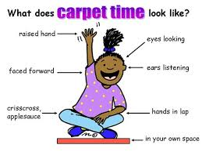
The classroom Environment
Furniture
Learning Materials
Learning Areas
Displays of work
Anchor charts

Slide 39
A List of Sites(Resources) That Help Develop Oral Language
http://www.education.com/reference/article/strategies-language-learning/
This is a great article about how parents/teachers/caregivers can interact with children at a young age. This might be a great article to send home to parents.
http://www.readingrockets.org/article/phonemic-activities-preschool-or-elementary-classroom
Reading rocket has a lot of information and activities specifically around oral language development. This specific site talks about phonemic activities for preschoolers and elementary students.
http://www.sedl.org/cgi-bin/mysql/framework1.cgi?element=syntax&andor=and&source=&sortby=element
This resource has many activities around syntax.
http://www.literacyconnections.com/orallanguage-php/
This resource is around oral language activities and strategies, that get students read
https://www.teachingchannel.org/videos/build-language-skills-through-the-arts-getty
https://www.teachingchannel.org/videos/middle-school-vocabulary-development
These are two teaching channel videos around vocabulary. They are done with older students with ELL in mind, but there is a lot of great information and ideas for second and third grade, even first.
Linking Language: Simple Language and Literac… (Kindle Edition) by Robert Rockwell, Debra Hoge
This is a great book, with a lot of great oral language activities. These activities could be done whole group and/or in small groups combined with reading as well. There is a Kindle edition on Amazon.

Slide 40
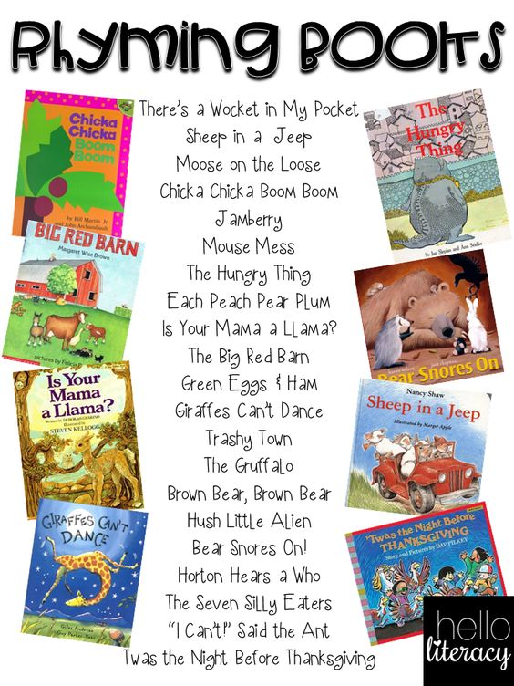
A List of books that cover vocabulary, as well as, rhyming.
Herd of Cows! Flock of Sheep! (Collective Nouns)
Suddenly Alligator(Adverbs)
Bullfrog Pops! (Verbs and Direct Objects)
Around the House the Fox Chased the Mouse(Prepositions)
Once There Was a Bull (Frog) (Compound Words)
Pig Pigger Piggest (Comparing)
Why the Banana Split (Idioms)
Just Me and 6,000 Rats (Conjunctions)

