Slide 1


Executive Function and Challenging Behaviors in Preschool-age Children
Miriam Kuhn, Ph.D.
University of Nebraska at Omaha
Courtney Boise, Ph.D.
University of Nebraska- Lincoln
Notes:
Both introduce ourselves: who we are and what our roles are right now
Courtney: facilitate group intros

Slide 2
This project was supported by a grant awarded to Drs. Susan Sheridan and Lisa Knoche by the Institute for Education Sciences (Grant #R324A120153). The opinions expressed herein are those of the investigators and do not reflect the funding agencies.

Slide 3
Self-Regulation
Executive Function
Inhibitory Self-Control
Flexibility
Emergent Metacognition
Attentional Control
Inhibiting
Emotional control
Shifting
Emotional control
Working memory
Plan/Organize
Notes:
COURTNEY
on
ISC: Ability to appropriately stop and modulate behavior, impulses, or emotional responses
FLEX: Ability to move freely from one situation, activity, or aspect of a problem to another, make transitions, and solve problems flexibly
WM: Ability to hold information in the mind to complete a task and stay with an activity
P/O: Ability to anticipate future events or consequences, use goals to guide behavior, develop/implement steps to carry out an activity
AC: Ability to voluntarily focus or sustain attention on a given task

Slide 4
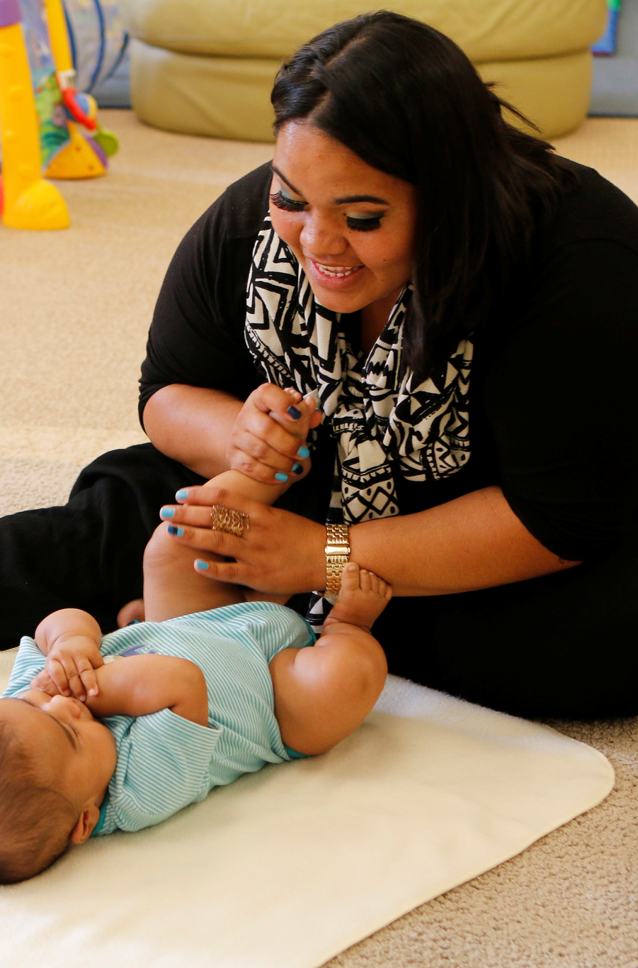
Goal
of the
Getting Ready Intervention
Promoting children’s learning and development by strengthening relationships and building competencies among families and professionals.
Notes:
MIRIAM

Slide 5

Key Outcomes of Getting Ready
Enhancement of children’s cognitive, language, behavioral, and social-emotional skills;
Development of supportive parent-child relationships;
Promotion of positive, constructive parent-professional partnerships.
Notes:
MIRIAM

Slide 6
We focused
on children in Getting Ready who were identified as displaying challenging behaviors
Notes:
MIRIAM Participants-- 19 children (mean age 3.9 years) 13 boys, 6 girls Found to have significant relationship between scores on two tools that measured challenging behaviors and problems with executive functioning. So, four of the children participated in a second year of preschool– we chose to collect qualitative information on these four children– interviewing parents, teachers, coaches who were helping the teams implement the Getting Ready partnership approach; also collected written documents from the teams– collaborative plans.

Slide 7


EF Competency– Working Memory
Definition | Participant Quote
Ability to hold information in the mind to complete a task and stay with an activity | No examples in the data.
Notes:
COURTNEY

Slide 8



EF Competency– Plan/Organize
Definition | Participant Quote
Ability to anticipate future events or consequences, use goals to guide behavior, develop/implement steps to carry out an action | No examples in the data.
Notes:
COURTNEY

Slide 9

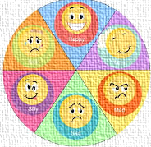

EF Competency– Inhibitory Self-Control
Definition | Participant Quote
Ability to appropriately stop and modulate behavior, impulses, or emotional responses | “He doesn’t do so well in the lines…he’ll get antsy…like the first time he ran into one of his friends and knocked him down and hurt him.”
Notes:
COURTNEY

Slide 10
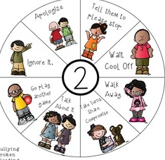

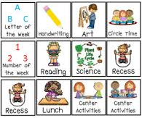
EF Competency– Flexibility
Definition | Participant Quote
Ability to move freely from one situation, activity, or aspect of a problem to another, make transitions, and solve problems flexibly | “You get him out of routine and it throws his day off. Like if the bus is broken and I have to take him, I mean it kind of throws him out of whack that day.”
Notes:
COURTNEY

Slide 11

EF Competency– Attentional Control
Definition | Participant Quote
Ability to voluntarily focus or sustain attention on a given task | “My child got distracted easily so conversations were about focusing.”
Notes:
MIRIAM

Slide 12

What About? Oppositional Defiant Behavior
Definition | Participant Quote
Pattern of angry/irritable mood, argumentative behavior, or vindictiveness | “Right now it’s accepting the teacher’s decision. He yells “no” at us a lot…He thinks it’s funny to leave the table, and come back, and leave the table at lunch, and come back…And he still, he just thinks that it’s fun and a game.”
Notes:
MIRIAM

Slide 13

Strategies

Slide 14

What our participants tried: Redirecting attention and scaffolding to increase persistence
“Helping her focus on and be persistent with something that… whatever the activity was… of choice.”
Notes:
COURTNEY

Slide 15

What our participants tried: Preparation for transitions
“He does better if he knows what’s coming next.”
“Like doing “OK, we got ten minutes” like if they’re playing outside, “We got 10 minutes” and then warnings.”
Notes:
COURTNEY

Slide 16
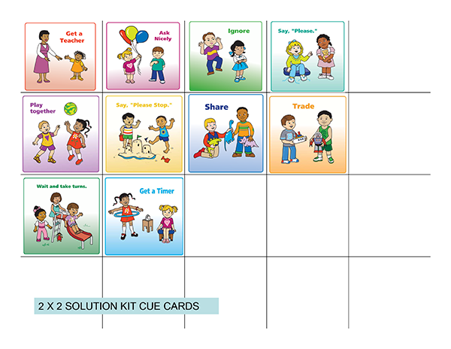
What our participants tried: Visual support
“We used a lot of visual cards. There was a couple that we used on, you know, instead of throwing yourself down on the floor what could you do? You could ask a teacher, you could ask a friend, you could calm your body down and then we had some ways of calming his body down.”
“We made cards of “this is what you did” “this is what you should have done” and “this is what you need to do”. If you threw a toy at your sister, you should have went to your mom and told her what happened, what do you need to do, you need to tell your sister you’re sorry. So a lot of the things we thought that he was getting disciplined, he didn’t know why he was doing it so when we had these visual cards, it helped mom and him at home. And when he came into the school, it helped him use a lot of his verbal skills instead of his tantrums.”
Notes:
COURTNEY

Slide 17
What our participants tried: Planned ignoring
“Sometimes I just walk away, and give her some time. And then… come back. And try it again.”
“If she doesn’t get something, she’ll throw herself on the floor, she’ll scream and I be like, I’ll tell her “When you’re done, you can come and talk to me” and a lot of times I’ll walk away from her. So most times, I won’t leave that room, but if she’s throwing her fit in the living room, I’ll go in the dining room and when she calms down she can come talk to me and we’ll talk it out.”
Notes:
MIRIAM
*murky, inhibitory self-control

Slide 18
A cautionary tale about “ignoring”
  Extinction does not work quickly.
  There is often an “extinction burst”– the behavior gets worse before it gets better.
  The behavior can spontaneously reappear.
Notes:
MIRIAM

Slide 19
What our participants tried: Function-based intervention
“Goal begins to hone in on how long it takes for him to comply. C. provides guidance for designing this goal- w/in a particular amount of time can be hard to measure, T. suggests after a certain # of requests and mom goes along with this idea. C. now guides discussion about the function of the behavior and reminds team they want to take that into account when thinking about strategies. Team comes up with function of getting attention or desire not to miss out by doing this self-help task, if he goes first behavior is better. Now C. guides discussion about reinforcement—explains the term for mom, things used to motivate or consequences. Team decides the plan will state what will happen when he does or does not comply. C. continues to shape the plan- target time for doing the strategy and for collecting data about the success (they decide they have to do it all the time, with every request).”
Notes:
MIRIAM- C. is the coach, T- teacher.

Slide 20
What our participants tried: Triage
“Last year, we had a lot of problems with letting adults be in charge when she first got here. So we pretty much did triage six times a day. So I would talk to her at least 2 of those times, and I usually had my teacher’s assistant and I had my special ed. assistant. (She shows me the triage sheet). And so we would just run through those and then the acceptable answers that she would give. And they were just a half-sheet that we would initial so that when she got home, mom would see that she answered all of the questions correctly.”
First, then:
“First, pick up toys, then ____________(preferred activity).”
Notes:
MIRIAM

Slide 21
Supporting Executive Function & Positive Behavior
 | Classroom Organization (physical/ temporal environments) | Instructional Support (how I teach) | Emotional Support (social environment & emotional support)
Dramatic Play
Early Childhood Games
Neitzel, J. (2018). What measures of program quality tell us about the importance of executive function: Implications for teacher education and
preparation. Journal of Early Childhood Teacher Education, 39(3), 181- 192.
Diamond, A., Barnett, S., Thomas, J., & Munro, S. (2007). Preschool program improves cognitive control. Science, 318(5855), 1387- 1388.
Notes:
MIRIAM: set up

Slide 22

Notes:
URL for Dramatic Play– Evan and friends on the bus
https://www.cde.state.co.us/resultsmatter/evanelyaslyricanditiahonthebus

Slide 23
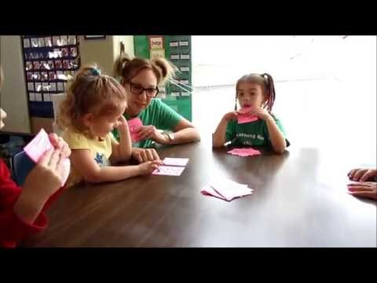
Notes:
URL for Card Game in Preschool
https://www.youtube.com/watch?v=YPXFdqWGk6k

Slide 24
Supporting Executive Function & Positive Behavior
 | Classroom Organization (physical/ temporal environments) | Instructional Support (how I teach) | Emotional Support (social environment & emotional support)
Dramatic Play
Early Childhood Games
Neitzel, J. (2018). What measures of program quality tell us about the importance of executive function: Implications for teacher education and
preparation. Journal of Early Childhood Teacher Education, 39(3), 181- 192.
Diamond, A., Barnett, S., Thomas, J., & Munro, S. (2007). Preschool program improves cognitive control. Science, 318(5855), 1387- 1388.
Notes:
MIRIAM & COURTNEY: Co-facilitate filling in the chart. (See instructor notes.)

Slide 25


References
Jones, S., Bailey, R., Barnes, S., & Partee, A. (2016). Executive function
mapping project: Untangling the terms and skills related to executive function and self- regulation in early childhood (OPRE Report # 2016-88). Washington, DC: Office of Planning, Research and Evaluation, Administration for Children and Families, U.S. Department of Health and Human Services.
Kuhn, M., Boise, C., Marvin, C., & Knoche, L. (2019). Executive function and
challenging behaviors in preschool-age children: Reports from parent- professional partnerships. Manuscript submitted for publication.
Marvin, C. A., Moen, A. L., Knoche, L. L., & Sheridan, S. M. (2019). Getting
Ready strategies for promoting parent–professional relationships and parent–child
interactions. Young Exceptional Children. doi: 1096250619829744.

