Slide 1
MindfulnessTechniques that Support Improved Execution Function
Dr. Jolene Johnson

Slide 2
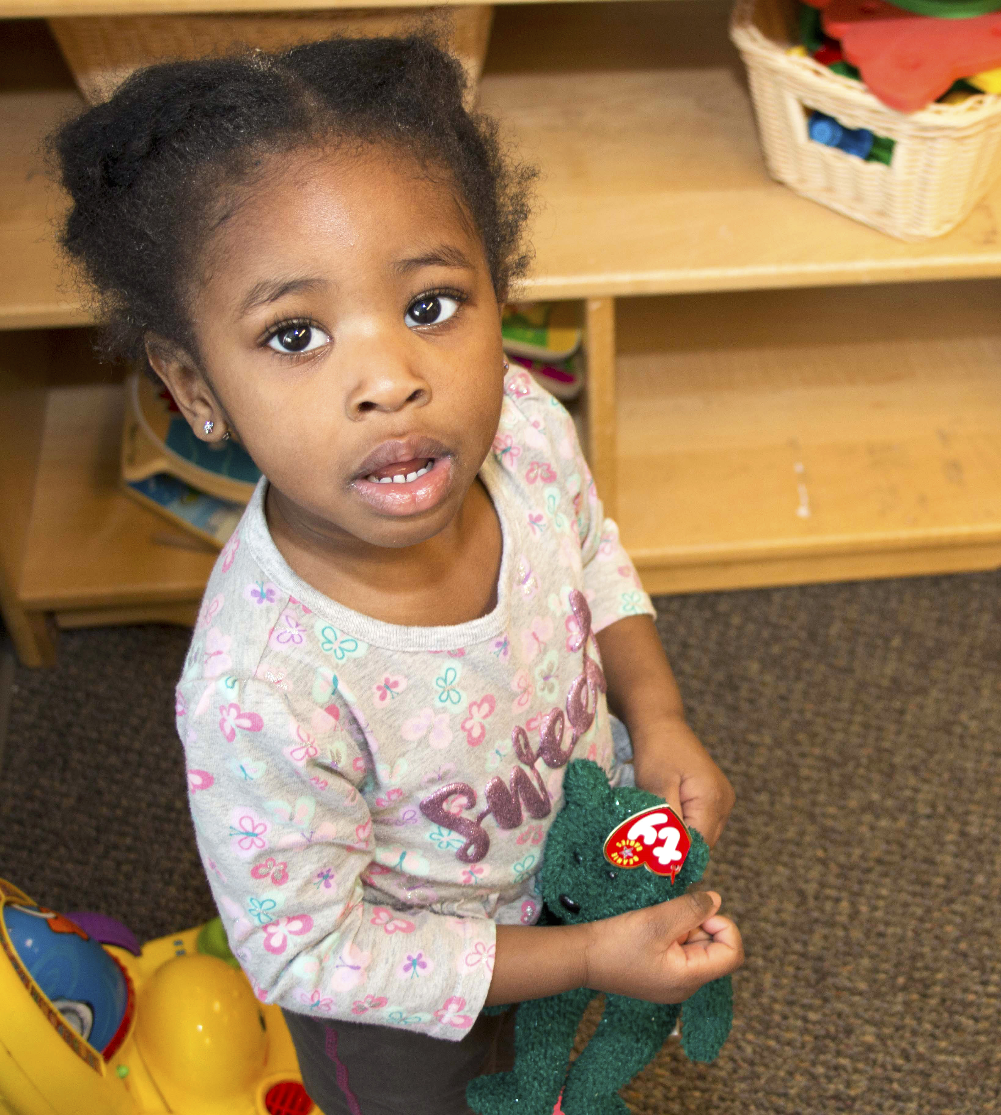
Welcome!
Mindfulness Strategies for the Classroom

Slide 3
Mindful Moment

Slide 4
Mindfulness
What is Mindfulness?
Paying attention,
on purpose,
in the present moment,
non-judgmentally
(Kabat-Zinn)
Notes:
What is Mindfulness?
It is the buzzword of the day.
It is becoming mainstream, in part, because of the strong science behind it, as we talked earlier. It is showing positive results.
But WHAT IS IT?
Here’s the very classic definition: Mindfulness is paying attention, on purpose, in the present moment, non-judgmentally.
Let’s dig into that a little more.
Maybe it would help to ask this question.
What are we doing when we are being mindful?
We are intentionally directing our attention
To what? To the present moment, to what is happening here and now.
In what way? In a non-judgmental, curious, and compassionate way.
Attention is the essence of mindfulness.
Let’s think about attention for a moment.
:40
NO:
When we are being mindful, we are retraining our habits of attention.
Today, we will take a short, but hopefully helpful, tour of what it means to be mindful.
How many have a regular mindfulness practice?
How many people in this room have had some exposure to mindfulness?

Slide 5
Why Mindfulness?
Research on children ages 4 – 18
Executive Functioning
Attention
Memory
Focus
Depression
Anxiety/Stress
Negative Behaviors
Notes:
Because in the last decade or so, convincing evidence has accumulated that show that young children who do mindfulness activities have better EF, attention, memory, focus, emotional control, and less problematic behaviors, mental flexibility, empathy and cognitive abilities.
These positive effects appeared in preschoolers after 8 – 12 weeks of mindfulness curriculum, 2 or more times a week.
Since mindfulness has been show to support EF development in children, and since we know that EF is a strong predictor of later academic and social outcomes, we thought it would make sense to include it in our analyses.
So what did we find?
NO
reduced stress and anxiety. Adults are less likely to experience depression, are less stressed and anxious, have stronger immune systems,

Slide 6
Process of creating the Overlay
Identify Gaps in SEL Curricula
Survey Teachers’ Needs
Assemble Content
Curriculum Overlay
Conscious Discipline
Pyramid Model
PATHS
Second Step
Interviews
Field Testing and Refining
Notes:
If you are following in the booklet of slides, a couple of slides got switched after the booklet was printed. Just want you to know, The information is the same, just in a different place. Thanks for your flexibility on this.
I’m going to quickly walk you through the process of creating the overlay.
The sites that are currently participating in this Acceleration Grant are using one of the four SEL curricula.
Conscious Discipline PATHS Pyramid Model Second Step
When I talk about the Overlay, I am referring to activities and curriculum that were created or obtained to supplement these SEL programs.
First we looked at the SEL programs to see if we could identify any gaps in the curriculum, specifically in the domains of self-regulation and executive function.
Then we interviewed teachers in focus groups and asked where they saw gaps and where they needed supports.
And from that we assembled content and created the overlay.
Let’s talk about the first two steps.

Slide 7
Gap Analysis
High
Low
Medium
Very Low
 | Mindfulness | Emotional Processes | EF - Cognitive Regulation | Pro-Social & Learning Skills
Conscious Discipline
Pyramid Model
PATHS
Second Steps
Notes:
Here is the color coded gap analysis. Dark means we found a high representation of that domain, and white means very low.
So, for instance PATHS is higher in Emotional processes, and prosocial learning skills, and lower in cognitive regulation, and mindfulness.

Slide 8
Overlay
EF
Cognitive Regulation
Mindfulness
Concrete strategies
In-the-moment activities
Short in duration
Teacher
Interviews
Mindfulness Activities
Brain Games
Notes:
We identified the domains that needed overlay activities.
Next we interviewed teachers to see where they needed support.
The teachers said that they needed
Go-to, concrete strategies to help children self-regulate
In-the-moment activities to refocus attention
Short in duration for Transitions, routines
From this came the Mindfulness Activities
For the Cognitive Regulation Overlay piece, we are using the Brain Games, which you will be trained on this afternoon.

Slide 9
Co-construction of Activities
Research Activities /
Select Pool
Field Test with Teachers
Refine and Retest
Final Activities
Video Tape for PD
Notes:
So how did we create the activities?
I am going to quickly explain how we co-constructed the activities.
First off, a pool of mindfulness activities that already had been written, that fit our criteria, were selected. Also, some of the teachers created their own activities, or suggested adapted activities.
Then I worked with 6 lead teachers from infant, toddler and Prek classrooms in Omaha and Lincoln and we field tested these activities over a couple of months.
each week of the field testing, each teacher had 3 different activities that they tried and experimented with during that week.
Once a week I would visit and watch, sometimes video record the activities being taught. Then the teacher and I had a feedback session and the teacher talked about what she saw, what worked, what didn’t, what she would change.
Some of the activities worked great, some didn’t work at all, and some needed refinement.
When an activity needed refinement, we brainstormed for ways that would work, and the teacher then tried that activity again for the next week.
It was a circle of inquiry and refinement.

Slide 10
Activities
Breathing Ball
Pinwheel Breathing
Breathing Hands
Breathing Buddy
Puppet Show
Tone Bar
Yoga Story
Notes:
We started with around 15 activities, we ended up with these 8.
Some activities are for all three age groups
Some are only for specific ages.
6 of these activities can be used in-the-moment, on the fly.
We also included 2 activities that are a little more planned, but are good ways to anchor the mindfulness concepts you are teaching.
We’ll talk more about these activities in a moment.

Slide 11
Mindfulness Practice & Training
Mindful breathing
Focusing on the sensations in the body
Meditations
Notes:
Mindfulness Practices or training can involve mindful breathing, focusing on sensations in the body, or meditations
Meditations can be done anytime; while walking, eating, sitting, listening, etc.
**Also, sometimes people think that they have to sit down and meditate to practice mindfulness. This isn’t true. You can choose to practice mindfulness at any time. In your classrooms, taking a deep inhale and exhale and noticing the feelings in your body, for 5 seconds is being mindful.
Also, taking one minute each day, only one minute, and practicing mindfulness counts.

Slide 12
Mindfulness – EF connection
Practicing mindfulness requires attention to the present moment.
Attending to the present moment requires you to notice and guide your attention.
Guiding your attention underpins executive functioning.
Practice strengthens this ability.
Notes:
Mindfulness improves children’s EF because it strengthens their ability to guide their attention, regulate the emotions, and be less impulsive, all of which are needed to plan and direct behaviors to achieve goals.

Slide 13
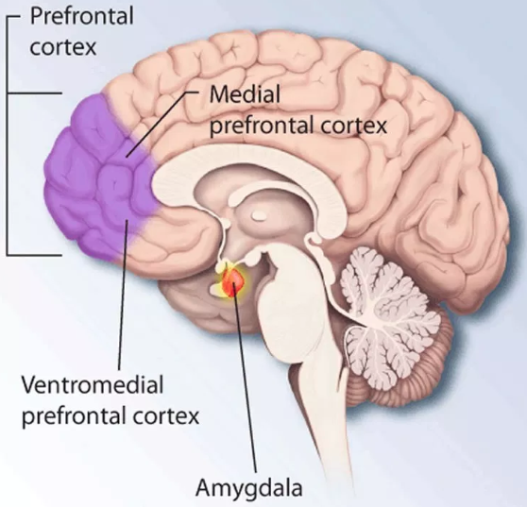
The Mindfulness EF connection in the Brain
Self Regulation and EFs
Emotions and Reactions
Notes:
What happens in your brain when you are practice mindfulness?
In a nutshell, In the process of responding to stimulation, the brain’s activity gets shifted away from the amygdala, where the stimulation can be perceived as a threat, resulting in a fight, flight or freeze reaction,
to the prefrontal cortex, where the ability to think more reflectively and with more flexibility is located.
This results in less impulsiveness and reactivity and more self-regulated behavior and thinking.
Again, the more mindfulness is practice, the easier it is for the brain to shift the processing of information from the amygdala to the prefrontal cortex.

Slide 14
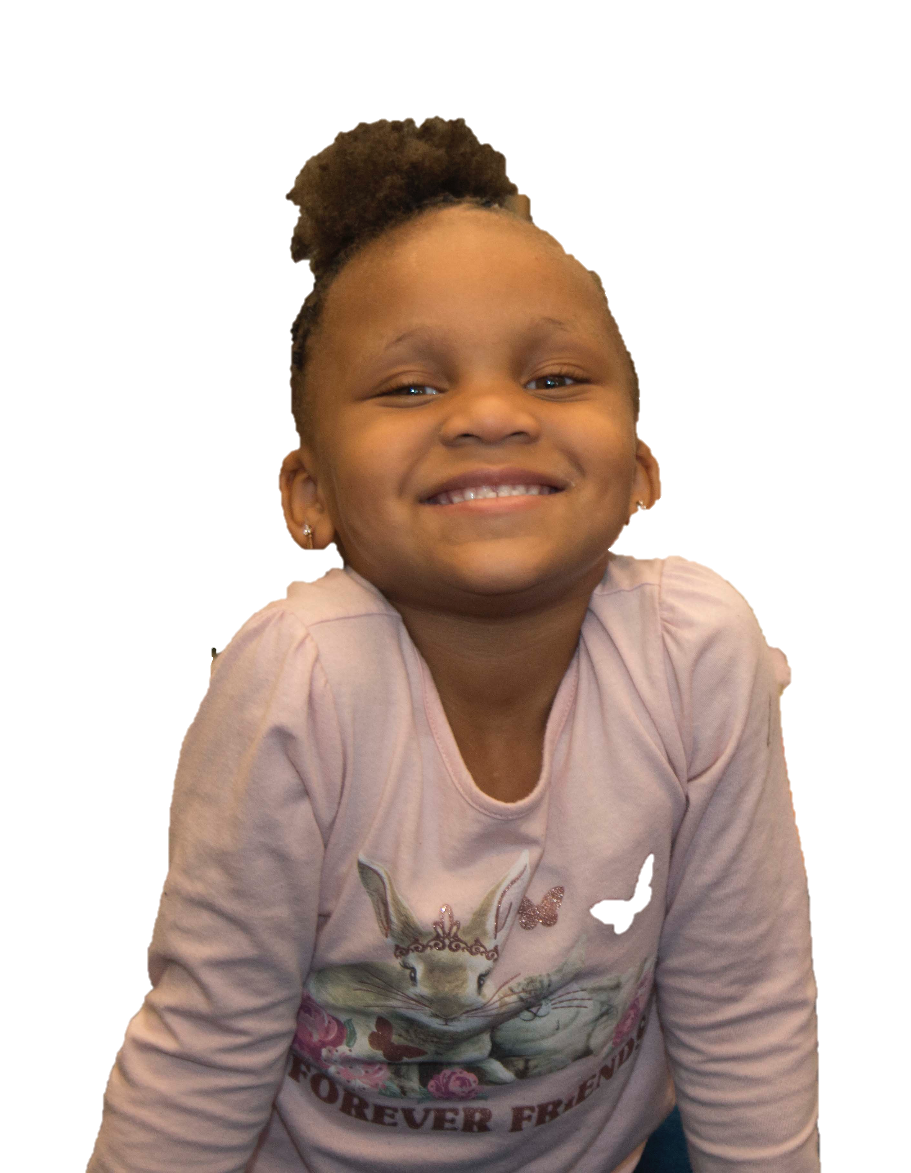
Mindfulness
What is Mindfulness for children?
Breathing
Calming the Body and Mind
Noticing Sensations
Noticing Inner Experiences
Reflecting
“Inner Power”
Notes:
So, what is mindfulness for Children?
For young children, mindfulness begins as an embodied experience. We help them practice directing their attention to their breathing and what it feels like to have a calm body.
That’s what today’s activities you will be learning are about.
I spent a lot of time helping you understand mindfulness, so that
1) you will really understand the underpinnings of what we are teaching children to do
2) So you can think about what mindfulness means to you, and how you might model it to your students.
For the overlay we aren’t using the word mindfulness. Instead we are telling the children they are building their Inner Power.
This corresponds to other Super Powers you will be learning about during the Brain Game training.
So, overall, remember that our objective with children is to help them learn to guide their attention.
We start with sensations in the body, and calming the body.
And that practice is key.
1:00
NO:
Even toddlers can come aware of the sensations that go along with happiness and frustration, and that blowing on a pinwheel, for instance, helps them feel better.
By around age 4 children are able to use the strategies on their own.

Slide 15
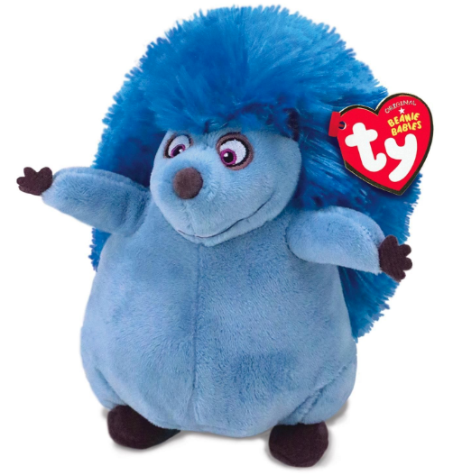
Let’s get started
Materials &
Activity Cards
Next:
Modeling the activity
Watch a Video
Discuss
Notes:
Brain Bags – Materials we will be using in today’s activities. These are yours to take back to your site and use in your classrooms/training.
Activity Cards – we’ll be demonstrating 8 of these activities today.
The cards are color coded; Blue for PreK, Orange for Toddler and Green for Infant.
Let’s get started with the training.
We will go through 8 activities.
First, I will model the activity as if I am the teacher and you are the kiddos, and we will do the activity together.
We’ll then watch a video of the activity being implemented in a Educare classroom. You will have access to these and other videos for your site training.
Then, we’ll take a couple of minutes for your to discuss the activity within your site group.
1:00

Slide 16
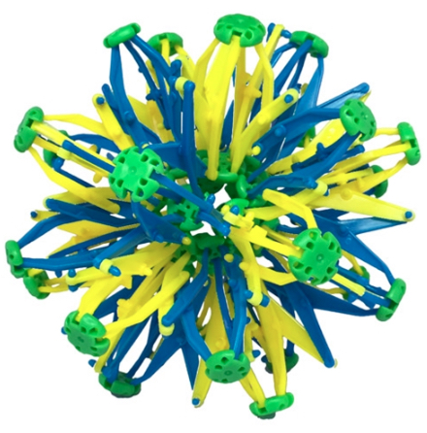
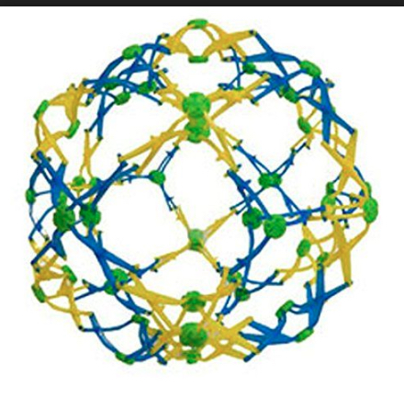
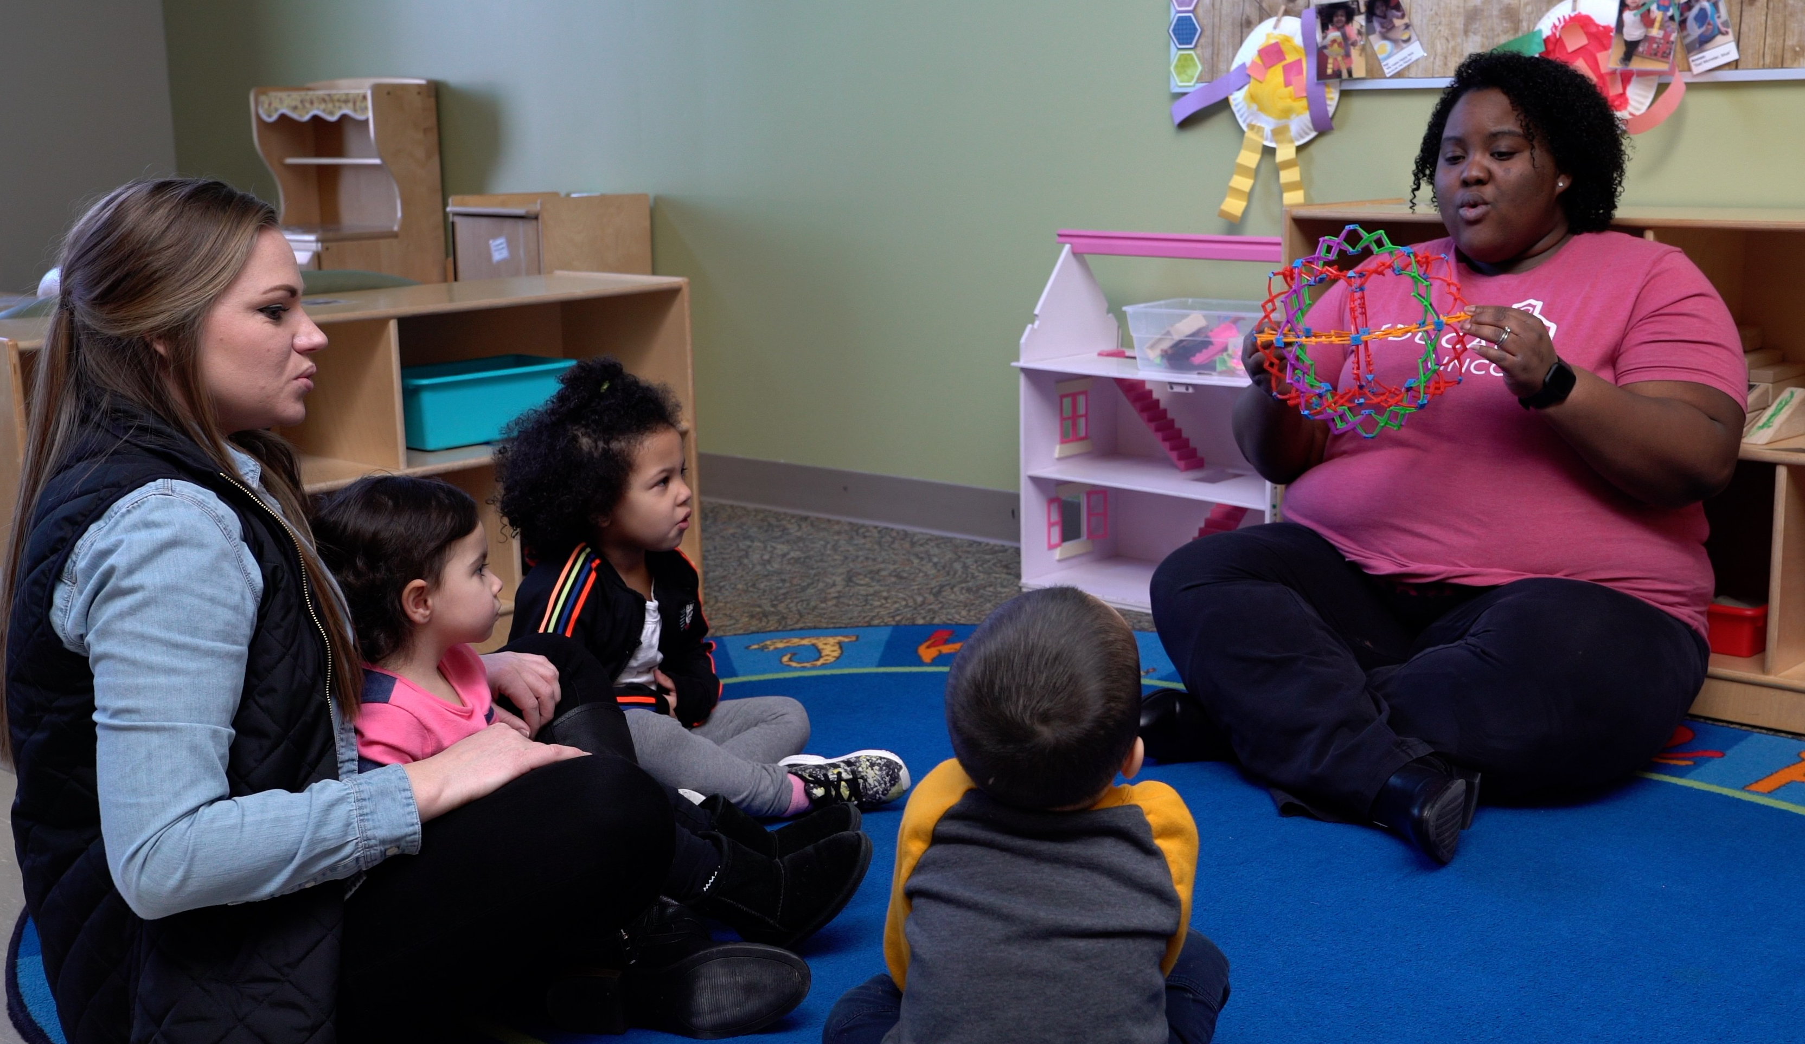
Breathing Ball
Pro Tips
First build background knowledge
Use the hand motions
Individual use
Notes:
The first activity we are going to do is the breathing ball. You can get the ball out if you want, or you can just watch and participate.
If you want to get the PreK card out, that is what I will be modeling.
On each card there is a script you can follow, but it is just a guide to get you started. As you will see in the videos, the teachers adapted the script to fit their need.
The objective of this activity is to help children become aware of their breath, and to experience the calming effect of deep breathing.
One pro tip, before introducing this activity, familiarize the children about the concepts of breathing and breath, so the children have background knowledge.
AFTER: A couple of other tips:
-Use the hand motions
-Connect to science, by talking about our lungs and how our lungs function.

Slide 17
Reflect
Where do you see this activity fitting into your current curriculum?
What are the challenges you see with activity?
Other thoughts:

Slide 18
Breathing Hands
Pro Tips
Eyes open or closed
Individual use
Anytime, anywhere
PreK Video
Notes:
This next activity is called Breathing Hands, and we field tested this in the PreK classrooms.
The objective of this activity is to offer children a strategy they can use independently, anytime, anywhere, to calm themselves.
All you need for this activity is Your Hands.
So, let’s begin.

Slide 19
Reflect
Where do you see this activity fitting into your current curriculum?
What are the challenges you see with activity?
Other thoughts:

Slide 20
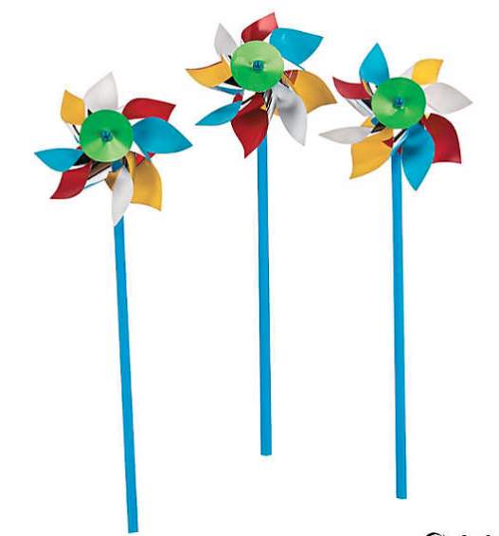
Pinwheel Breathing
Pro Tips
Model first and then hand out pinwheels
Science integration (fast, slow; cause and effect
Notes:
Everyone loves pinwheels, right?
This next activity is Pinwheel breathing and we field tested versions of this activity in PreK, Toddler, and Infant classrooms.
This activity helps children explore their breathing and how different types of breathing affects our bodies.
For this activity you will need a pinwheel for each child. So, get your pinwheel from your Brain Bag.
The teachers in the field testing modeled the activity first and then gave each child their pinwheel.

Slide 21
Reflect
Where do you see this activity fitting into your current curriculum?
What are the challenges you see with activity?
How could you use this with individual students?

Slide 22
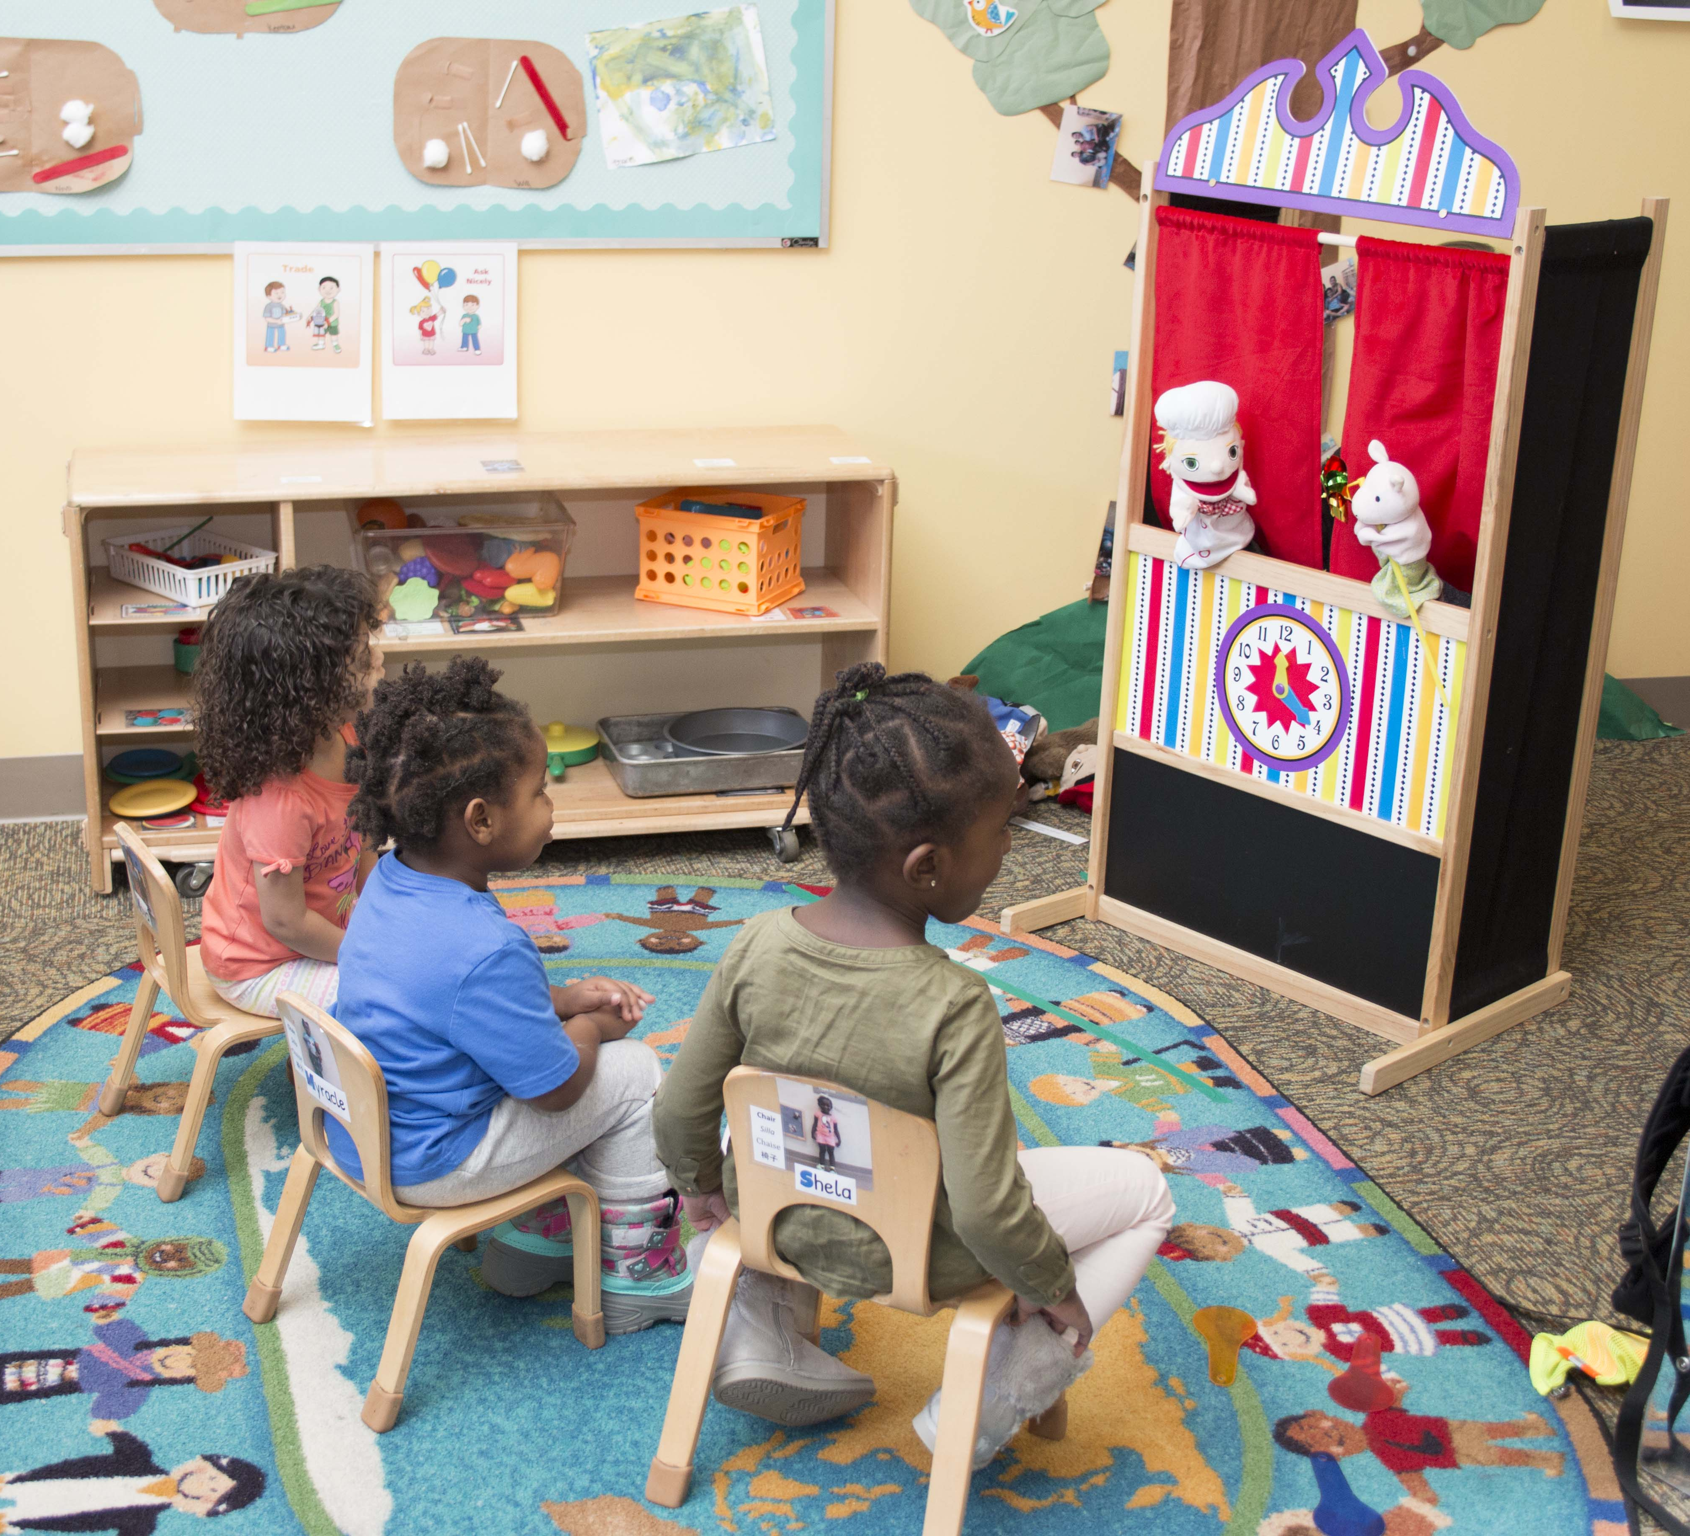
Puppet Show
Pro Tips
Can be short
Any strategy works
Have children interact with the puppets
How could older students take the lead on this?
Notes:
As we all know, stories are a good way to communicate a lesson or teach a strategy, and can be used to anchor a concept.
This next activity uses a puppet show to reinforce the mindfulness activities.
Christina Nelson, a Toddler Lead Teacher at the Lincoln Educare, wrote a puppet show to reinforce the different calming strategies she is teaching.
The script of her puppet show is on your activity card, and this script can be a template for any strategy you would like to emphasize.
So, we won’t do a puppet show now, but let’s watch Christina’s puppet show with her older toddlers.
This puppet show is about using the pinwheel to help children calm down when they are upset.
AFTER: Another variation on this is to have the children interact directly with the children. Perhaps the puppet can ask the child a question, such as “How can Piggy calm her body?”.

Slide 23
Reflect
Where do you see this activity fitting into your current curriculum?
What are the challenges you see with activity?
How could you adapt this for older/younger students?

Slide 24
Breathing Buddy
Pro Tips
A small stuffed animal for each child
The child can silently say the words “up” and “down” to help focus
Notes:
This next activity is a favorite for children. It is called Breathing Buddy.
Everyone has a stuffed animal in your brain bag. Let’s pull it out now.
The goal for the child is to put his animal on his belly and rock it to sleep by breathing deeply.
This activity helps children practice their deep breathing and relax their body through pretend play.
Let’s listen to what Dr. Daniel Goleman says about this activity. Daniel Goleman is the author of Emotional Intellegence, was a co-founder of the Collaborative for Academic, Social and Emotional Learning, and currently co-directs the Consortium for Research on Emotional Intelligence in Organizations at Rutgers.
Children lie down on the ground for this, and you are welcomed to do that, or you can just get comfortable in your chair.

Slide 25
Reflect
Where do you see this activity fitting into your current curriculum?
What are the challenges you see with activity?
Other thoughts:

Slide 26
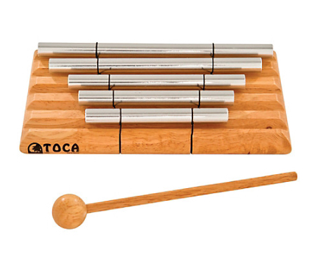
Tone Bar Focus
Pro Tips
Vary the lengths of ringing
If a child does not want to close their eyes, have the children turn around
Notes:
The next activity, the Tone Bar Focus, helps children focusing their attention through listening.

Slide 27
Reflect
Where do you see this activity fitting into your current curriculum?
What are the challenges you see with activity?
Other thoughts:

Slide 28
Yoga Story
Pro Tips
A visual is helpful, but not necessary
Choose poses that work for your children
Incorporate breathing into the poses
Notes:
Another way for children to practice focusing their attention is through yoga, which is a mindfulness activity too.
And building a story around yoga makes it fun.
To write a yoga story, you write a 5 – 9 line story and you match a yoga pose for each line.
You write these lines on a card along with an illustration of the story and a picture of the pose and you have a yoga story. As you can see here.
This yoga story is by Christine Nelson of Lincoln Educare

Slide 29
Reflect
Where do you see this activity fitting into your current curriculum?
What are the challenges you see with activity?
Other thoughts:

Slide 30
Teacher Data
Activity | Ease of Implementation | Average Time
Breathing Ball | 7.74 | 3.58
Breathing Hand | 7.13 | 5.06
Breathing Buddy | 7.09 | 3.09
Pinwheels | 7.81 | 4.00
Puppets | 7.00 | 5.29
Tone Bar | 7.46 | 1.85
Yoga Story

Slide 31
To learn more about Mindfulness
YouTube videos:
Daniel Goleman and Richard Davidson:
Does Mindfulness Really Work: What Science Tells Us
Daniel Goleman:
How Attention Helps Us Succeed
Flow, Focus and Frazzle
Websites:
Center for Healthy Minds - University of Wisconsin
https://centerhealthyminds.org
Center for Mindfulness – University of Massachusetts Medical School
https://www.umassmed.edu/cfm
Center for Mindfulness – UC San Diego Health
https://health.ucsd.edu/specialties/mindfulness/introductory-programs/what-is
American Mindfulness Research Association
https://goamra.org/

Slide 32
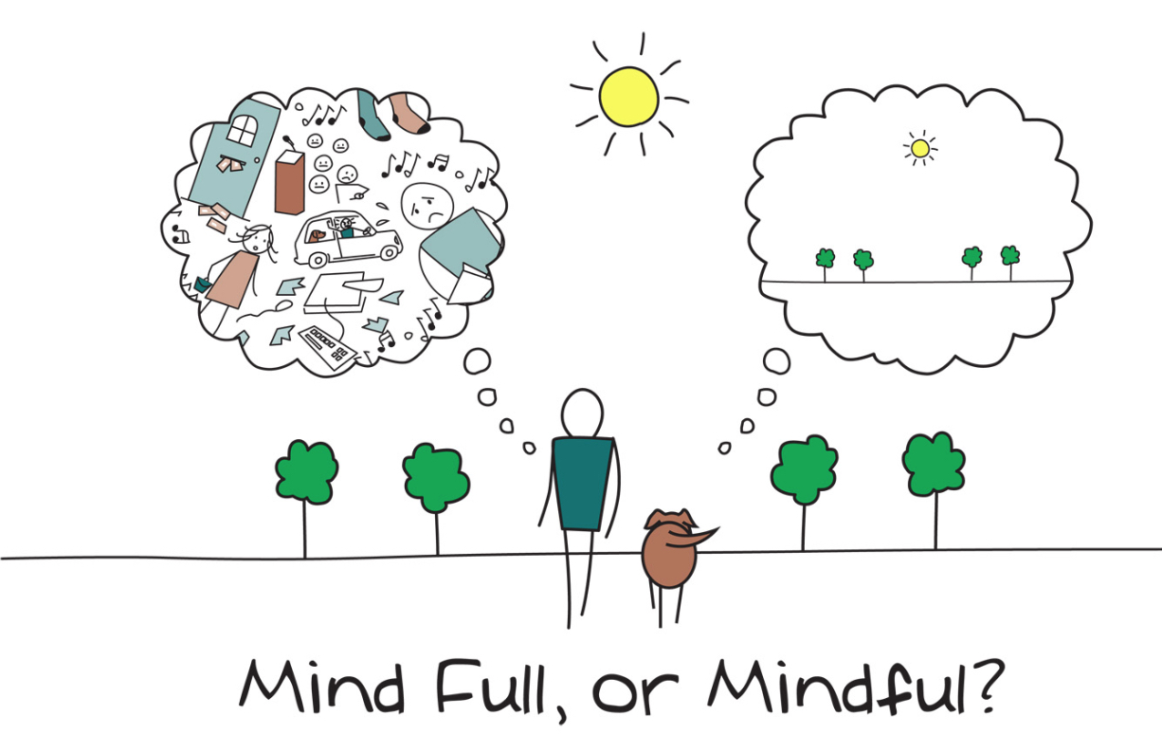
Notes:
So, hopefully, this short tour of mindfulness was helpful, as you take these mindfulness activities back to your sites.
Please feel free to ask me any questions over lunch.
Going forward I hope that we all can take even a couple of minutes each day to breathe deeply and be compassionately aware of what is happening in our inner worlds, and in the inner worlds of those around us.
Thank you for your attention.

