Slide 1
QUALITY
What It Looks Like
What it Costs

Slide 2

Quality
What Does It Look Like???

Slide 3
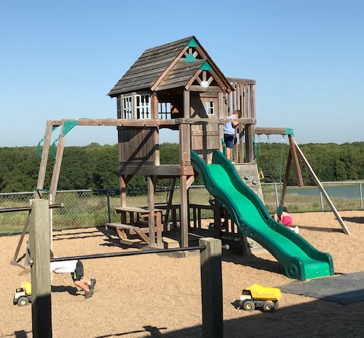
Quality as it relates to:
    Practices
    Materials
    Facility and Furnishings
    Teachers

Slide 4
Quality Practices

Slide 5

Five
Essential Practices
The early Learning Lab

Slide 6
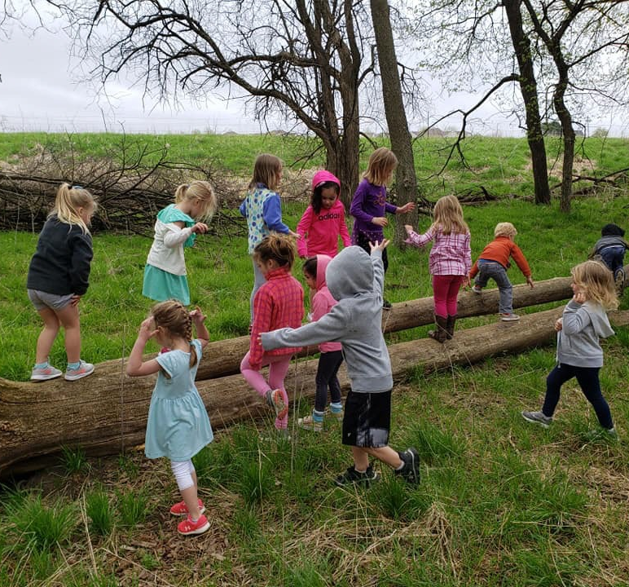
1. Provide rich learning activities that build on the child’s interest. Create a world of wonder by knowing what a child is excited about – extend learning using natural interests.

Slide 7
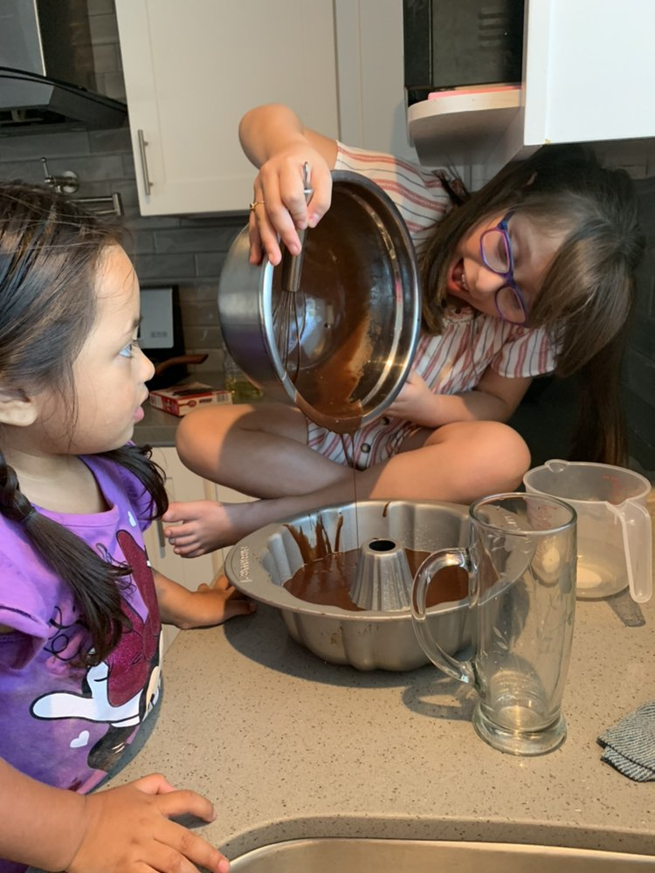
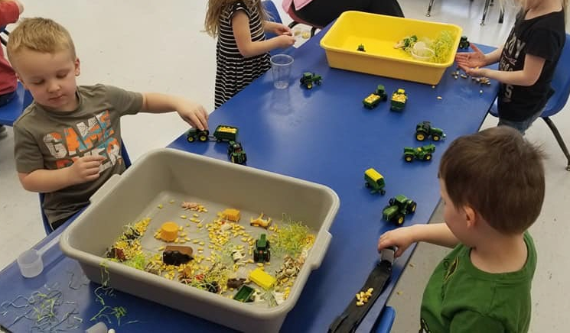
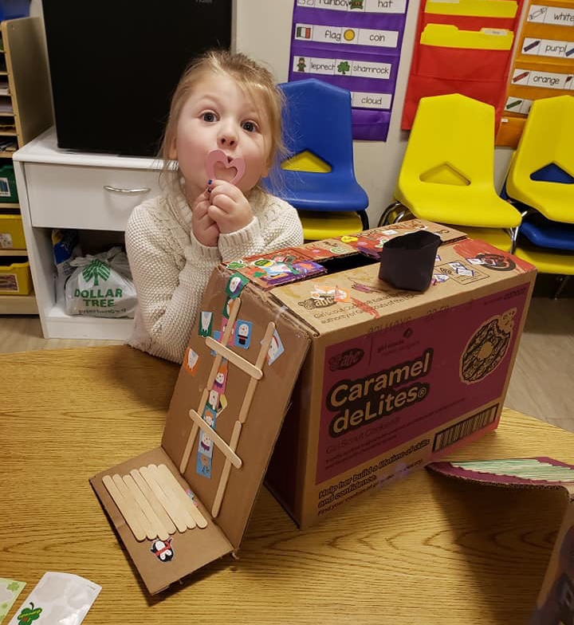

Slide 8
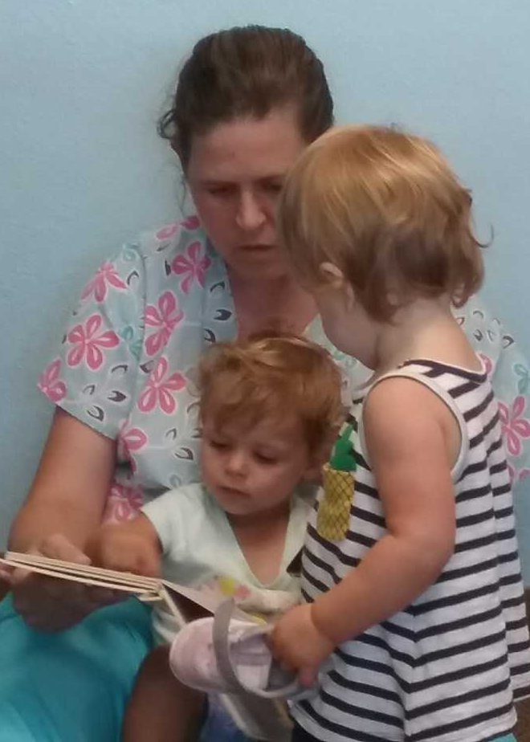
2. Read, sing, and tell stories: Use a variety of sounds, words, melodies, and rhythms to “bathe” or immerse children in language.

Slide 9
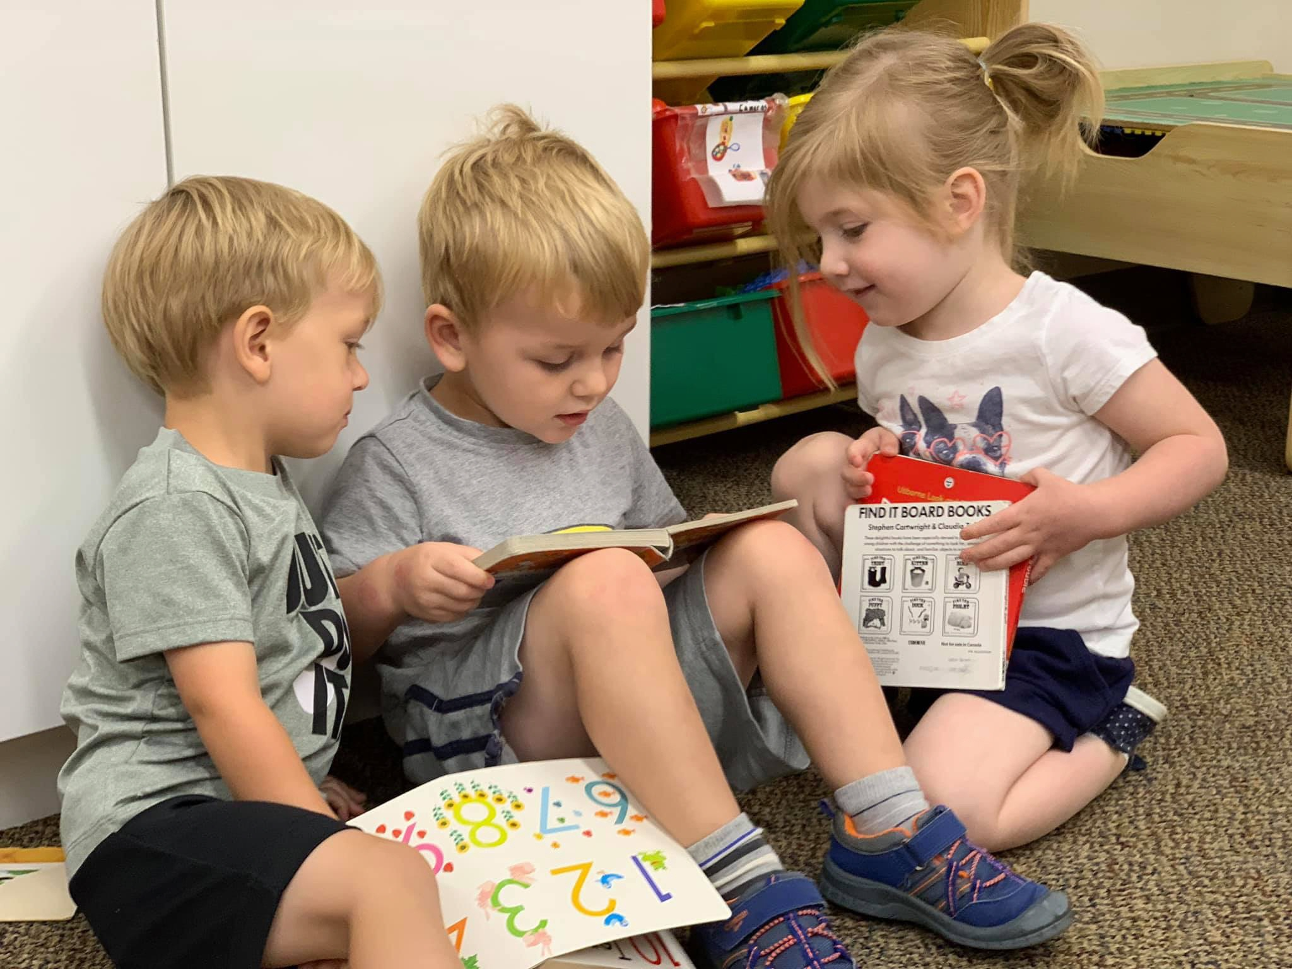
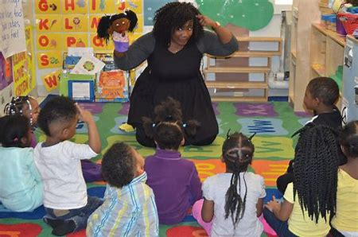

Slide 10
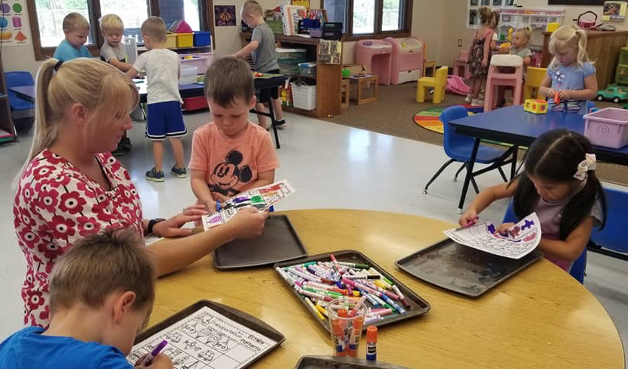
3. Know the stage of a child’s development and what comes next: Offer just the right amount of practice and challenge.

Slide 11
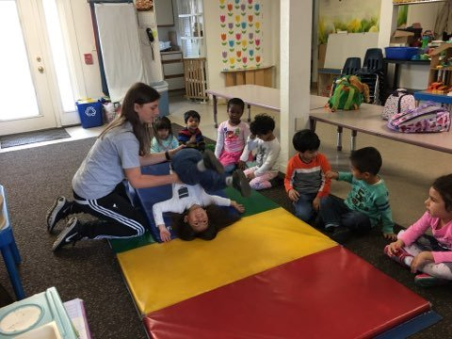
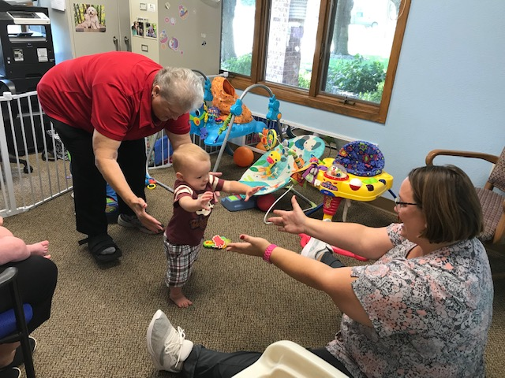

Slide 12

4. Create nurturing relationships and use positive guidance: Provide warmth and support, teach positive behavior, and prevent rather than punish challenging behaviors.

Slide 13
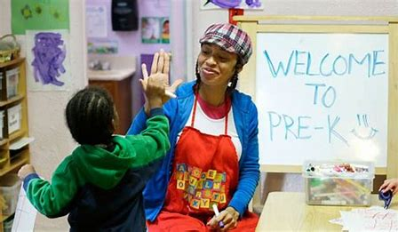
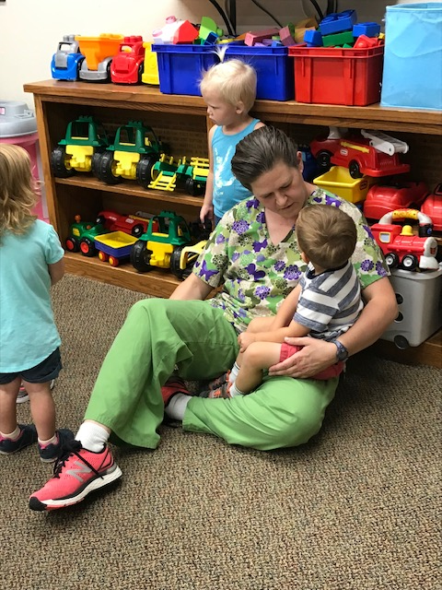

Slide 14

5. Be responsive and expand verbal and non-verbal communication. Build connections in a child’s brain through back and forth turn-taking, which supports language development and healthy bonds.

Slide 16
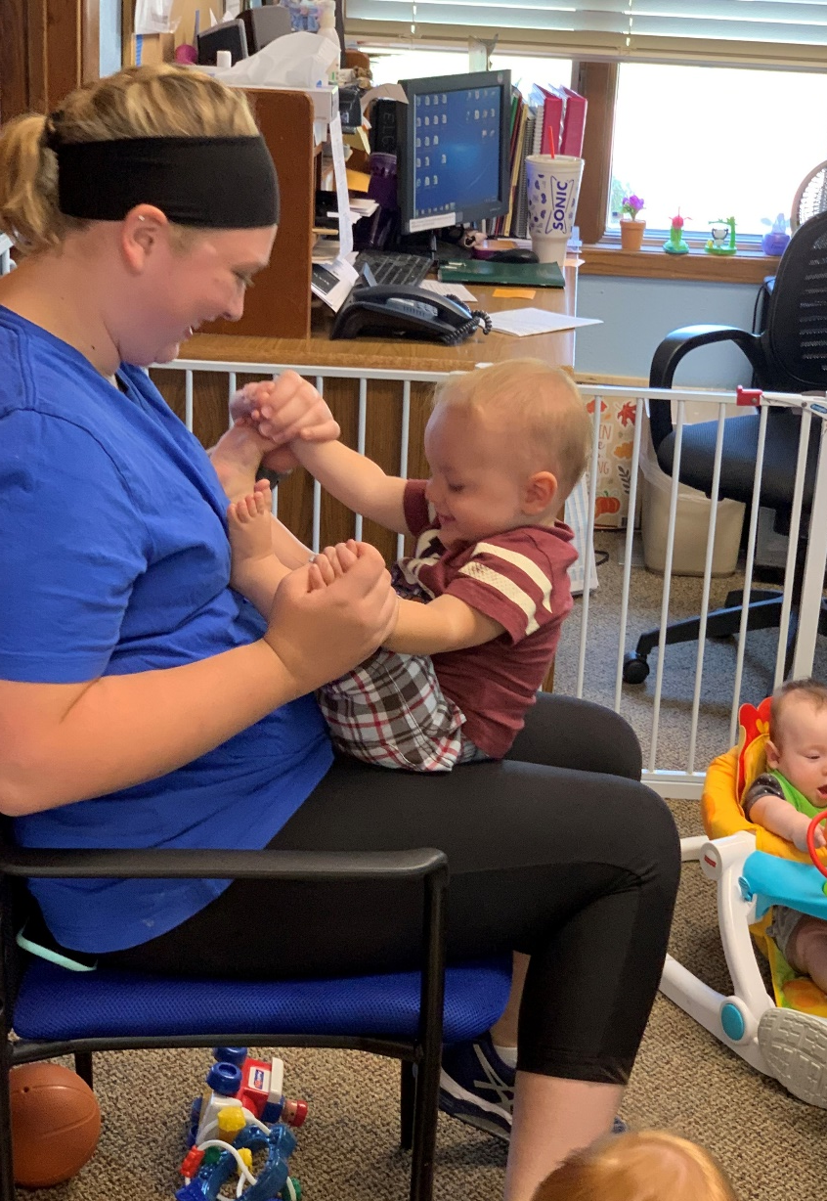
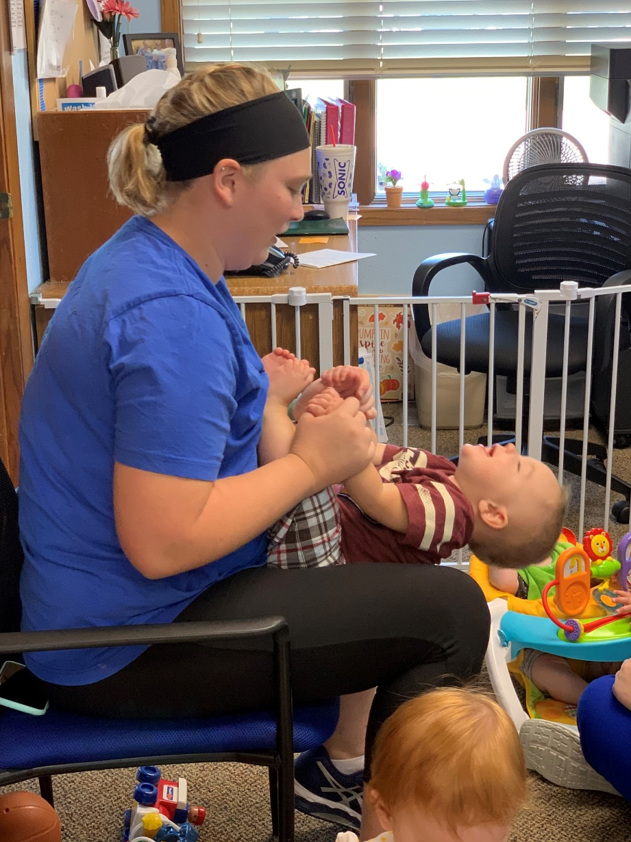
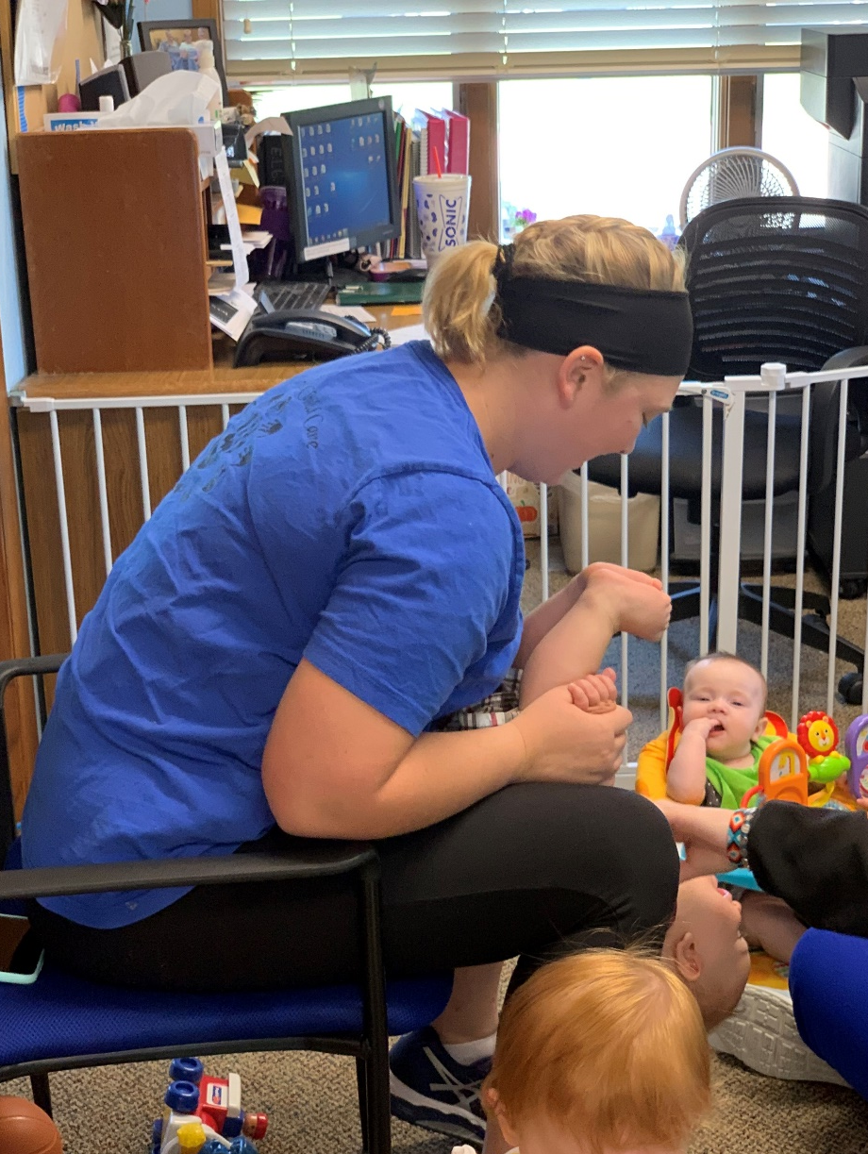
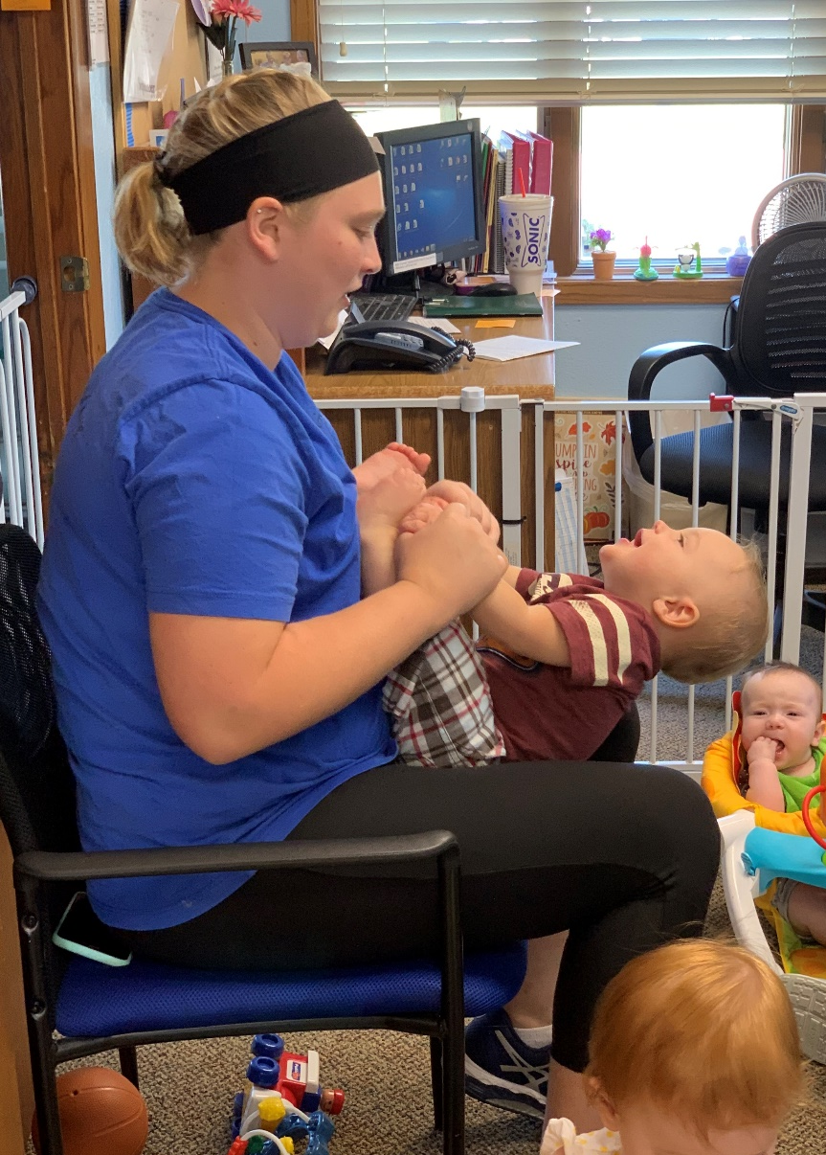
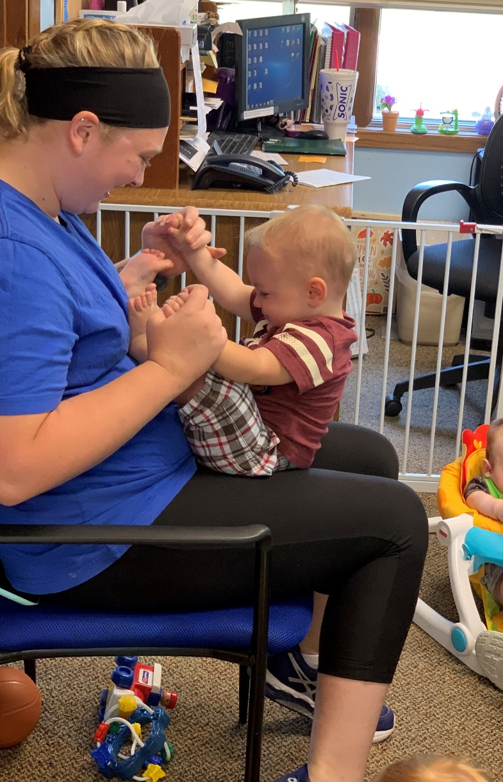

Slide 17

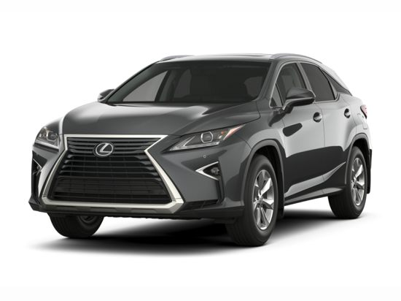
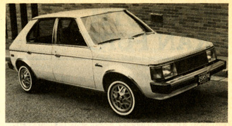
Does it have to have all the
Bells and Whistles to be quality?
Plymouth Horizon FORD
Lexus

Slide 18
Cost of Quality

Slide 19

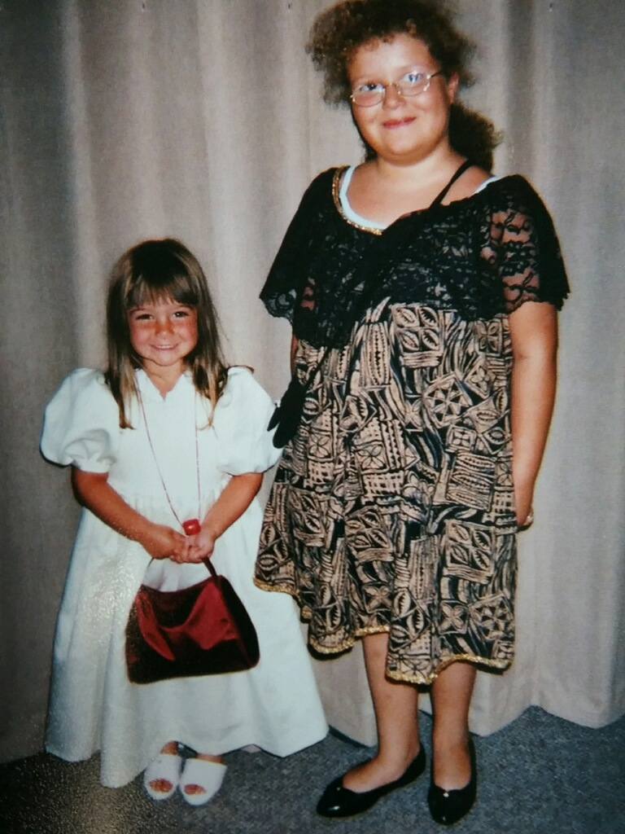

1. Provide rich learning activities that build on the child’s interest.

Slide 20
1. Provide rich learning activities that build on the child’s interest.
$149.99
$16.00

Slide 21

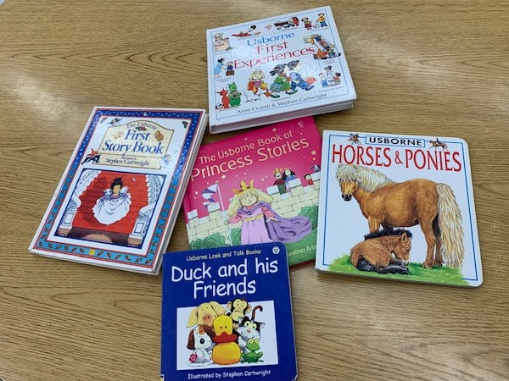
2. Read, sing, and tell stories
30 b00ks

Slide 22
2. Read, sing, and tell stories
$499
$0

Slide 23
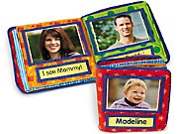

3. Know the stage of a child’s development… Offer the right amount of support

Slide 24
3. Know the stage of a child’s development… Offer the right amount of support
$29.99
4 for $2.97

Slide 25

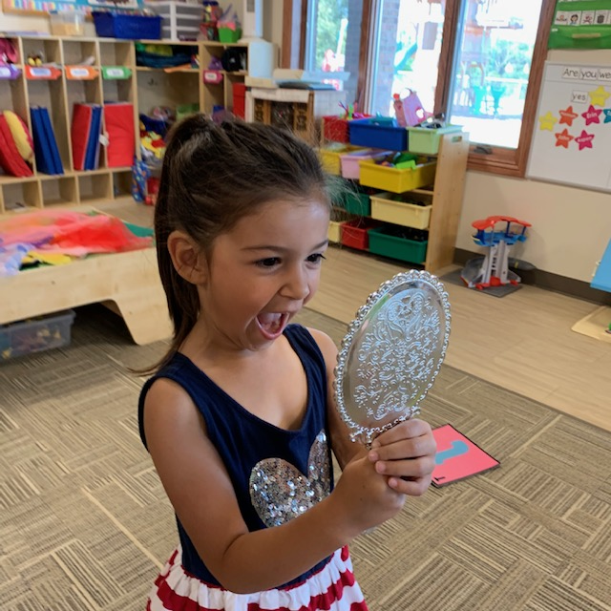
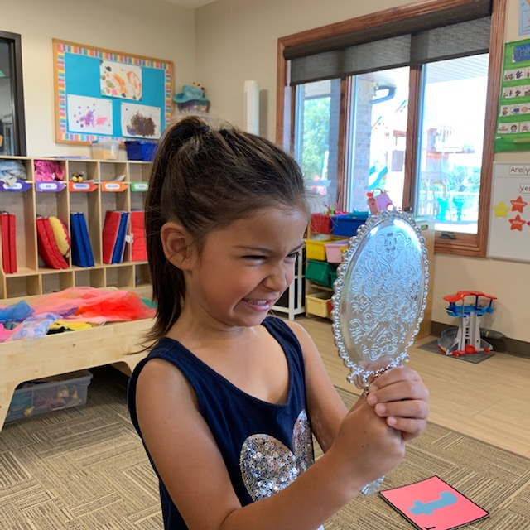
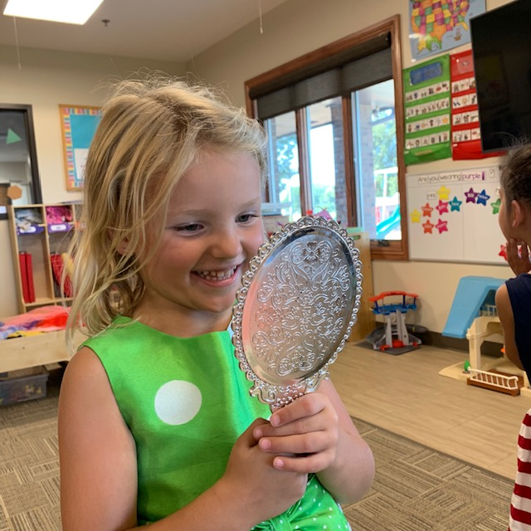
4. Create nurturing relationships

Slide 26
4. Create nurturing relationships
$14.99
$1

Slide 27
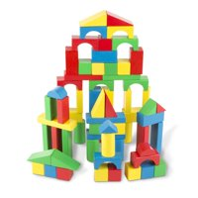
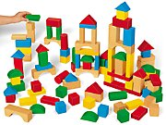
5. Back and forth turn-taking

Slide 28
5. Back and forth turn-taking
$29.99
$18.99

Slide 29
Facility and furnishings

Slide 30
To Build or Not to Build

Slide 31
Build or Renovate
Build
Renovate
Can build to your specifications
Typically more costly (architectural fees and cost of construction)
Renovations take less time than building
Extent of renovation will impact costs (replacing walls, kitchen ventilation versus child size toilets and adding in a doorway between classrooms)
Costs to meet ADA requirements
Availability of another space you could renovate

Slide 32
Facility Options
        Family Home
        Child Care Center
          Stand Alone Building
          Co-Located

Slide 33
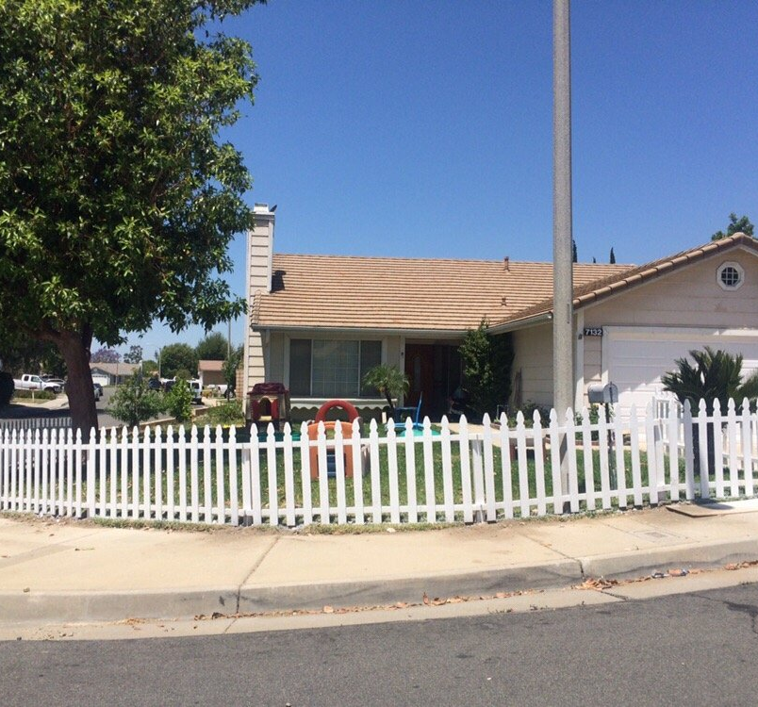
Family Child Care

Slide 34
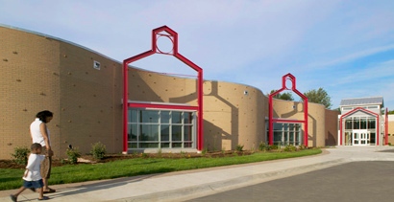
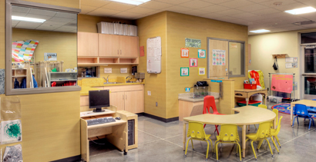
Child care center stand alone

Slide 35
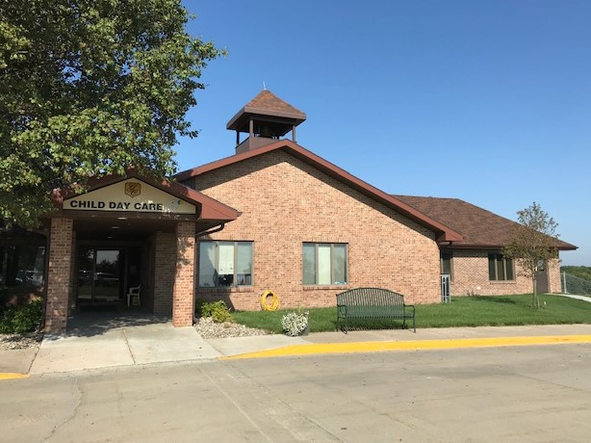
Child Care center co-located
Gold Crest Child Care Center
Adams, Nebraska

Slide 36
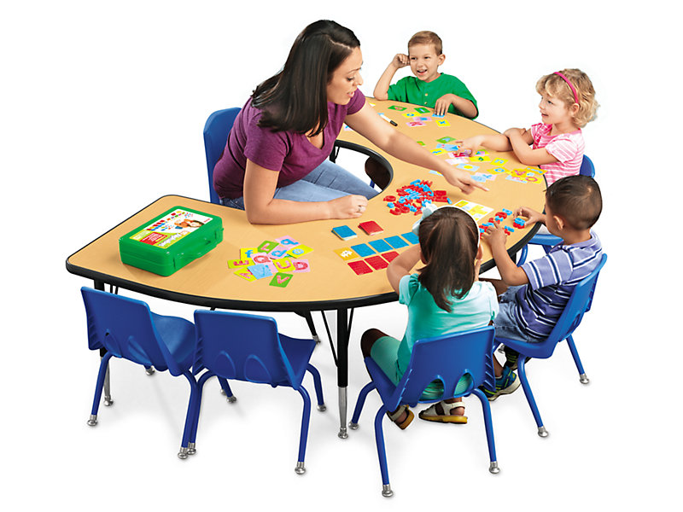
Furnishings Options
Rounded Corners
Adjustable height
Pay for durability

Slide 37
Facility Options
Child Care Center
Or
Family Child Care Center
Or
BOTH

Slide 38
Teaching Staff

Slide 39

Teachers
Level of Training
    Bachelor’s Degree – Early Childhood Credential
    Bachelor’s Degree – Related Field
    Associate Degree – Early Childhood Education
    High School / Child Development Associate (CDA)
    High School / Nebraska Early Learning Guidelines Trainings

Slide 40
Who to Hire…
    Hire the Highest Degreed Teacher You Can Afford
    Director/Coach
    Supplement with Ongoing Professional Development

Slide 41
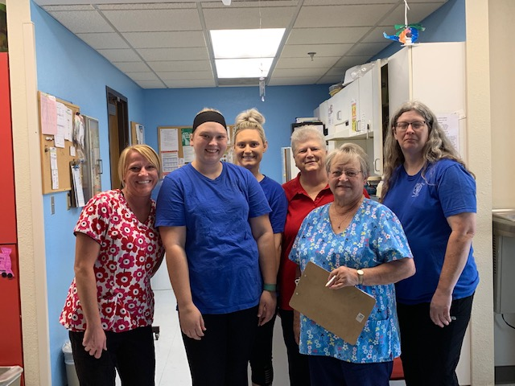
Picture of Adams Staff
Gold Crest Child Care Center
Adams, Nebraska

Slide 42
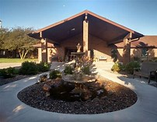
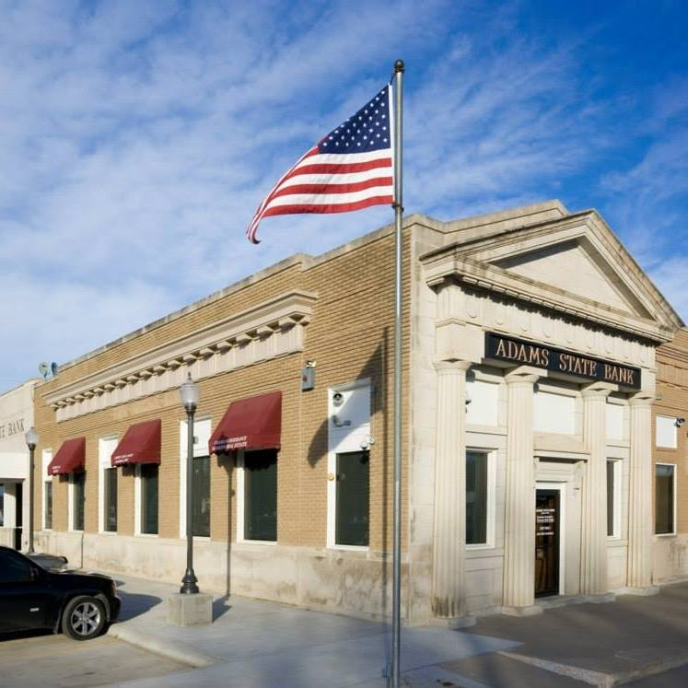
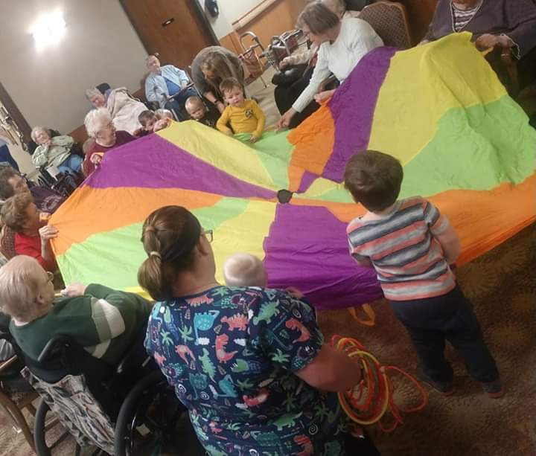
Community partners

Slide 43
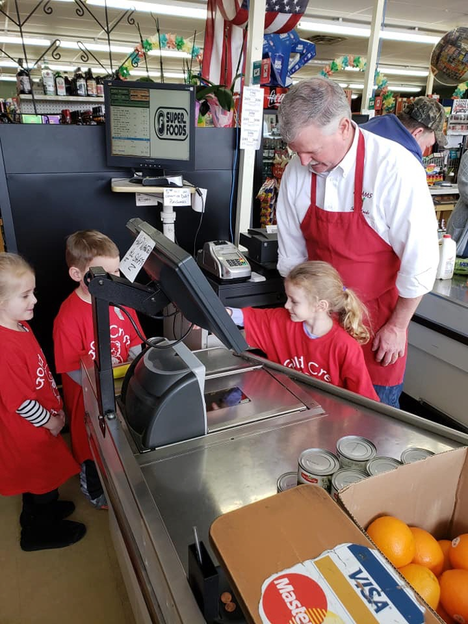
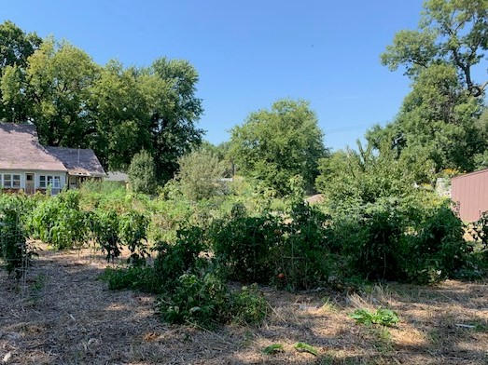
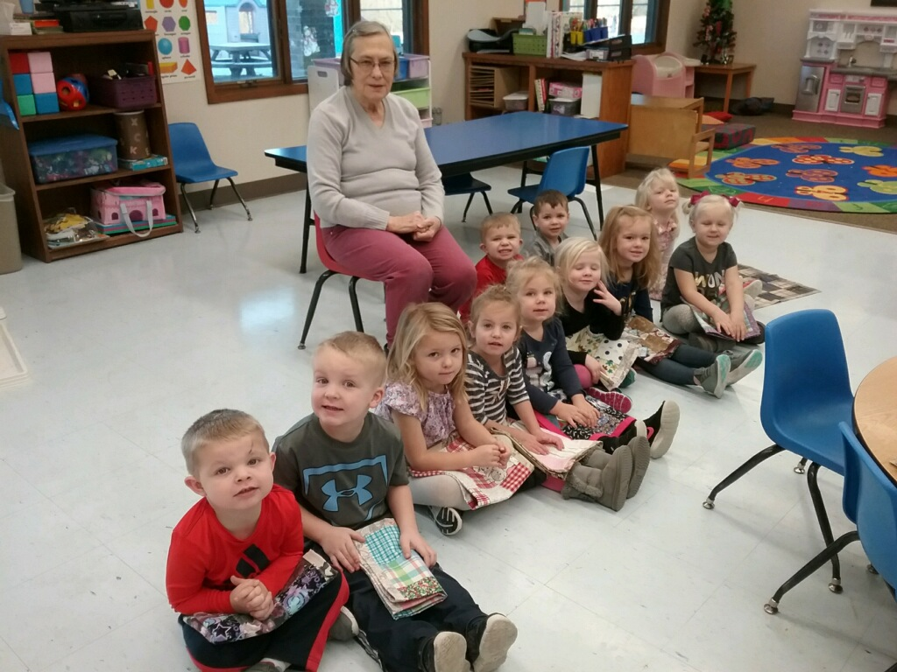

Slide 44

Closing Thoughts:
Quality evolves over time
Just Like Walking:
Start with Controlled Stumbling
Walking
Running
Skipping
Dancing

Slide 45
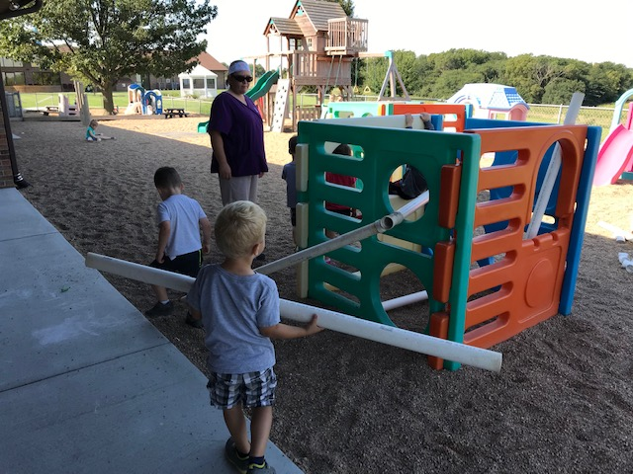
Questions?

